Slide 1
OVERVIEW OF INSTRUCTIONAL MATERIALS

Slide 2
Instructional Materials
In Classrooms, ‘Instructional Materials’ refers to:
Curriculum
Curricular Units
Instructional Units
Lessons
Resources
Assessments
Can only be created by those at the district level in Curriculum Manager
Can be created at the district/school levels AND by teachers.
Notes:
Before we start, useful to understand..
Curricular Units are collections of instructional units. These can only be created by users with the Curriculum Manager role. CUs are the largest pieces (building blocks) that make up curriculum
Instructional units are more granular chunks of CUs.
Lessons we all know. The lesson may be done fully in the Classrooms template or perhaps be an attachment to a file or a link to where the lesson actually lives.
Assessments should not be confused with standardized test and benchmarks (if applicable) found elsewhere in Schoolnet. Results from these tests can’t be loaded as data. However, they can include unit tests, quizzes, grading rubrics, etc.
Resources are a catch all for everything else. They can be attached to units or lessons or stand independently. Might include URLs, video titles (but not actual video clips), graphics such as maps, etc.

Slide 3
Curriculum Material Types & Relationships
CURRICULUM
Curricular Units
Resources & Assessments
CURRICULAR UNITS
Instructional Units
Resources & Assessments
INSTRUCTIONAL UNITS
Lesson Plans
Resources & Assessments
LESSON PLANS
Resources & Assessments
RESOURCES
ASSESSMENTS

Slide 4
Terminology: Curricular Unit
Curricular Unit
A term that is used to represent how the school year is broken up. This can differ by school type (Elementary, Middle, and High schools) and/or subject area.
SN is so flexible that it can accommodate differences by subject, grade, school type and district standard.
For example: Science K-5 may divide the school year in to six week cycles, while HS Accelerated Math may segment the year into Semesters.

Slide 5
Terminology: Instructional Units & Lesson Plans
Instructional Unit – divides a Curricular Unit into smaller topics
A Curricular Unit can be divided into as few or as many units as are appropriate.
For example: a Semester can be broken up into 1 Unit, 25, 50 , or 100+ units.
Lesson Plan – unit of instruction that addresses a theme/topic related to the Instructional Unit.
NOTE: Teachers can create
Notes:
In SN terminology we are referring to a syllabus that covers an ENTIRE Course and that is relevant to one subject. Of course, you can have a course that covers an entire year or a semester—that’s fine. The important concept here is that Curriculum refers to an ENTIRE course.
Curriculum – covers and entire course, 1 subject, grade
Next we have Curricular Unit.
Most districts don’t think that they have a term that specifically refers to CU, but once we define it they find that they do.
Assessment NOT benchmark:
if the math department has created sample chapter tests they would like made available to teachers in the district, they would load them into SchoolNet as assessments that are related to units of instruction which teachers are scheduled to teach

Slide 6
Terminology: Resources & Assessments
Resource – can be a passage, book, picture, audio file or another instructional support material:
A list of links to educational websites
PowerPoint presentation
Image file
Transparency
Assessment – how you will measure learning such as a rubric, unit test, or quiz. This is NOT a benchmark assessment.
NOTE: Teachers can create
Notes:
In SN terminology we are referring to a syllabus that covers an ENTIRE Course and that is relevant to one subject. Of course, you can have a course that covers an entire year or a semester—that’s fine. The important concept here is that Curriculum refers to an ENTIRE course.
Curriculum – covers and entire course, 1 subject, grade
Next we have Curricular Unit.
Most districts don’t think that they have a term that specifically refers to CU, but once we define it they find that they do.
Assessment NOT benchmark:
if the math department has created sample chapter tests they would like made available to teachers in the district, they would load them into SchoolNet as assessments that are related to units of instruction which teachers are scheduled to teach

Slide 7
Entering Materials (Instructional Materials)

Slide 8
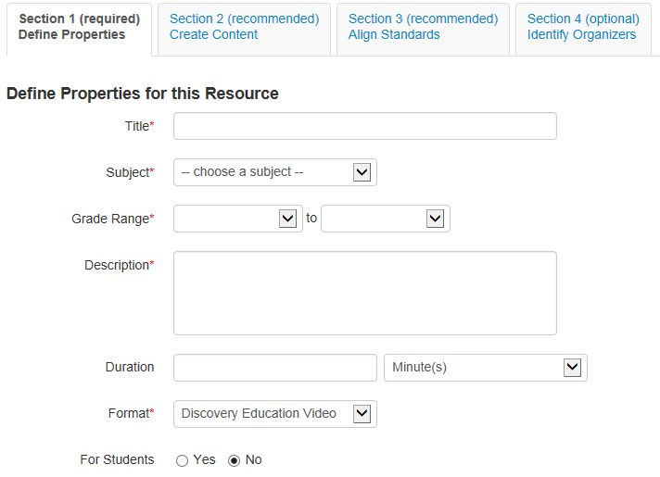
Defining Properties
For each material type, the first step is to
Define Properties.
When creating a resource, you will also enter a Resource Format.
Resources can also be created for Student Use

Slide 9
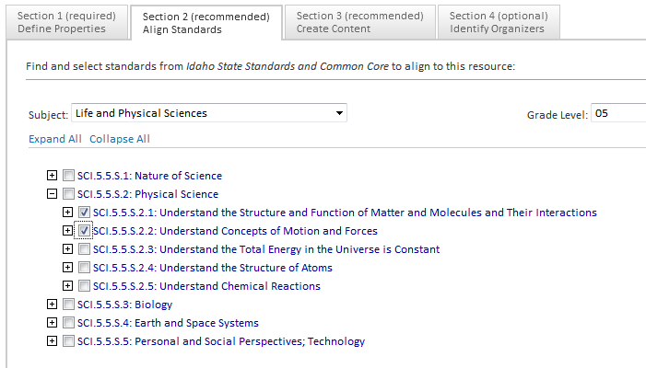
Aligning Standards
You can easily find and align standards to your materials (except Curricular Units).
Notes:
Standards are an optional inclusion for your new material.
Click the Standards tab. The Standards page appears, blank.
2. To add standards, locate them from the bottom left portion of your screen. Click the + icons to reveal the lower levels of standards.
3. Drag and drop the standards from the left side of your screen, to the right Standards page. Standards automatically appear.
4. You can also remove standards from your material by dragging and dropping the standard from the right Standards page back to the lower left Standards area.

Slide 10
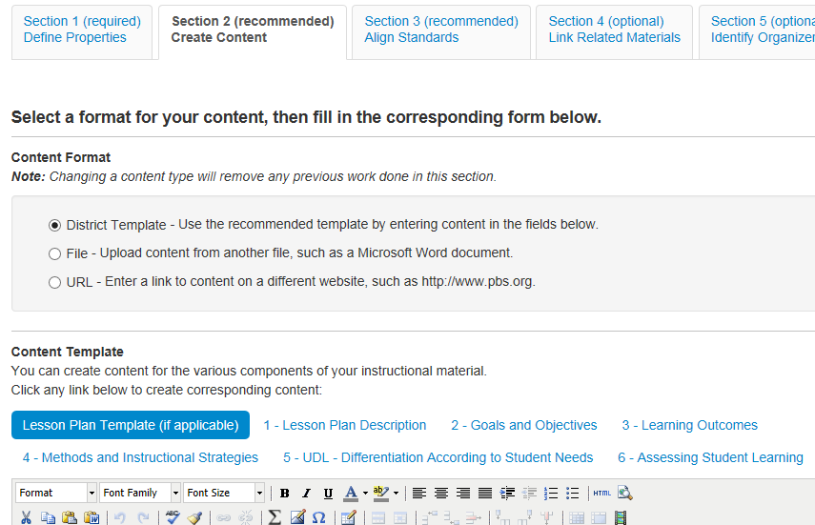
Adding Content
For most material types, there are three different options to add content: District Template (free-form text), File Attachment or URL. Each option varies in the information you are able to enter as well as how it displays in Schoolnet. You can only choose one option.

Slide 11
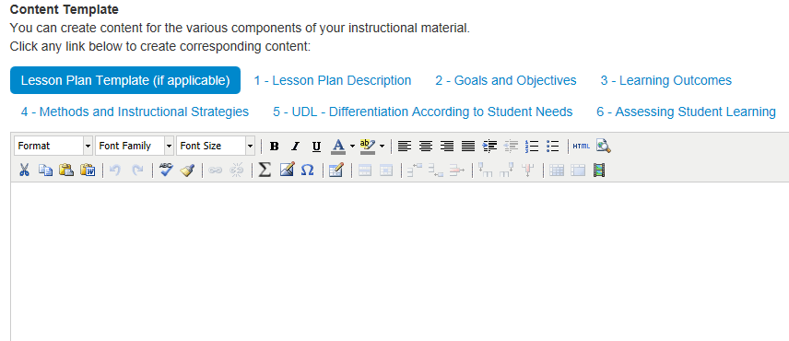
HTML Editor Toolbar
Formatting options
Math/Science Equation Editor
Include images
Table formatting options
Paste from Word

Slide 12
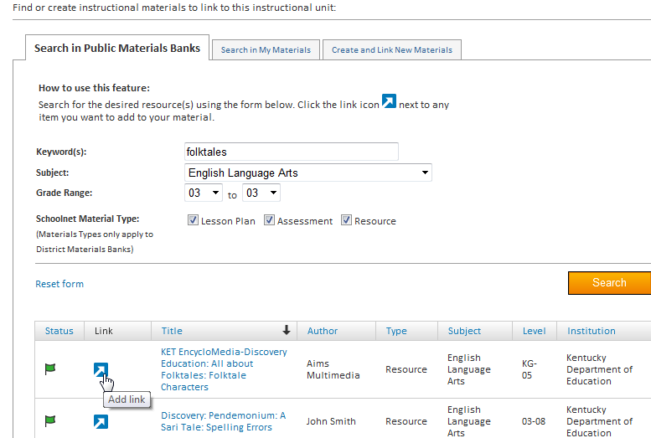
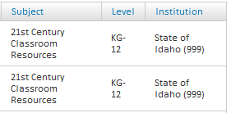
Link Related Materials
Materials can be linked to each other. You may wish to create Resources first so they will be available when creating ‘higher level ‘materials

Slide 13
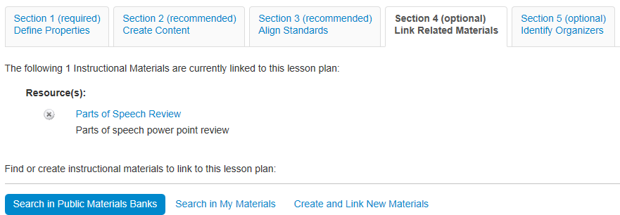
Attach Resources to a Lesson
Attach support materials to lessons
Use the same resource for multiple lessons
Notes:
Instructional units – Attach lesson plans, resources, and assessments
Lesson plans – Attach resources and assessments
This is the only way to add an attachment when using the district template
Can pull from bank, My Materials, or create on the fly; new resources become separate material
Show organizers in next tab
Show how to view detail to exit and return to lesson through My Materials

Slide 14
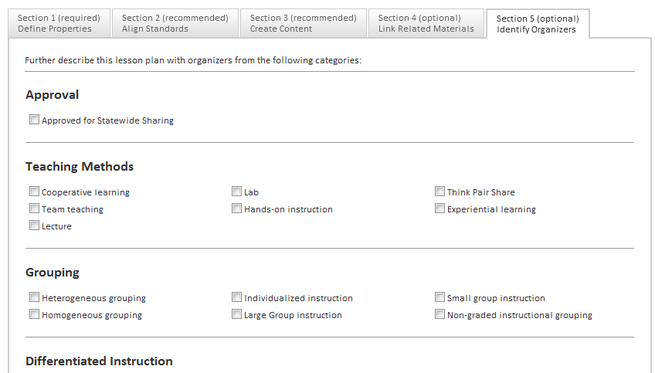
Organizers
Tagging materials by selecting organizers is a useful way to search for materials in Schoolnet. This can be done through the advanced search options.
Notes:
Adding Organizers
Organizers are an optional inclusion for your new curricular or instructional material.
1. Click the Organizers Tab. The Organizers page displays.
2. Select the organizer(s) you want to use by checking the box(es) next to the corresponding item(s).
3. With all your entries made, click Apply. Your additions are automatically saved.

Slide 15
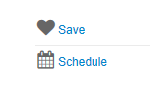
Navigating to My Materials
Add items to my materials from the overview or detail view

Slide 16
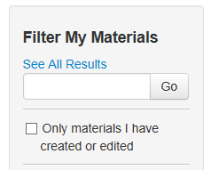
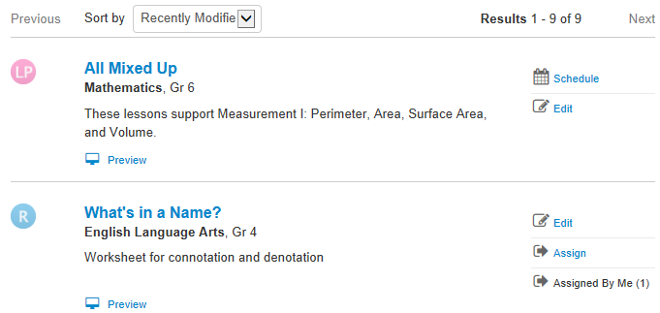
My Materials
A combination of the materials that you created and those you saved from a materials search
Notes:
This stays from one school year to the next
Filtering works the same way as in the Materials Bank

Slide 17
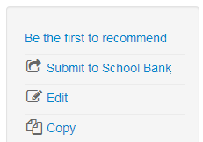
Submit a Lesson Plan for Approval Share with Other Teachers
Materials you create can be shared with other teachers by submitting for approval
You cannot edit the lesson plan once it is approved, however you can create and edit copies.

Slide 18
ACCESSING INSTRUCTIONAL MATERIALS

Slide 19
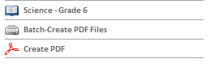
Locating Materials
In Classrooms
Materials Search
Throughout Classrooms
On Classrooms Home Page (for selected section only, once district maps curriculum to courses)
Notes:
By “curriculum”, we mean whatever scope and sequence, standards, units, etc., your district has organized and loaded for use with a particular course.
Not all courses have curricula assigned to them.
If a course or section does not have a curriculum mapped, the curriculum link will not appear in Classrooms home page or My Schoolnet

Slide 20
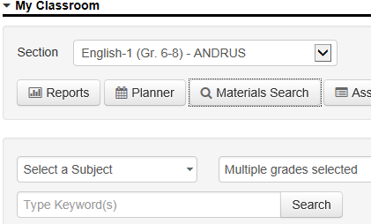
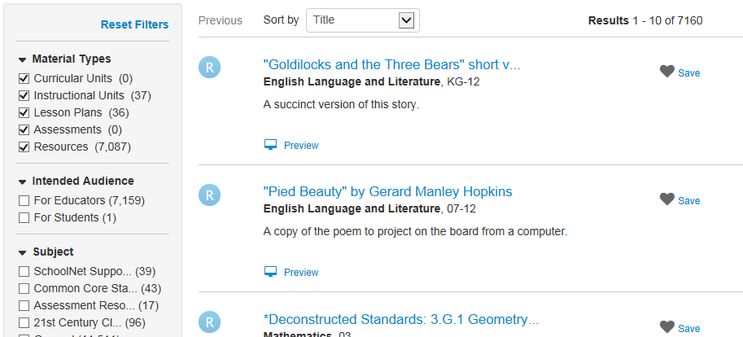
Search for Any Materials
Click Materials Search from
My Schoolnet
Filter by grade and subject
Notes:
Use this method to access curriculum for courses you do not teach (or that aren’t mapped to your course)

Slide 21
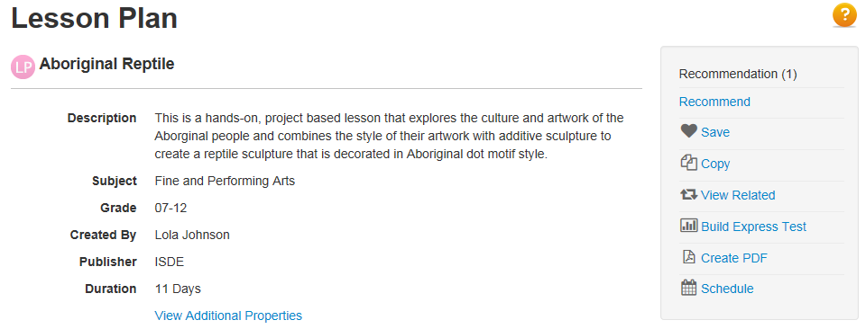
Materials Detail Page
View aligned standards and other materials tied to the same standards
Create PDF
Recommend
Save in My Materials for later
Build an Express Test (jump to Assessment Admin module, create test from standards aligned to selected material)
Schedule in your lesson planner (teachers only)
Notes:
Click materials title to access detail page

Slide 22
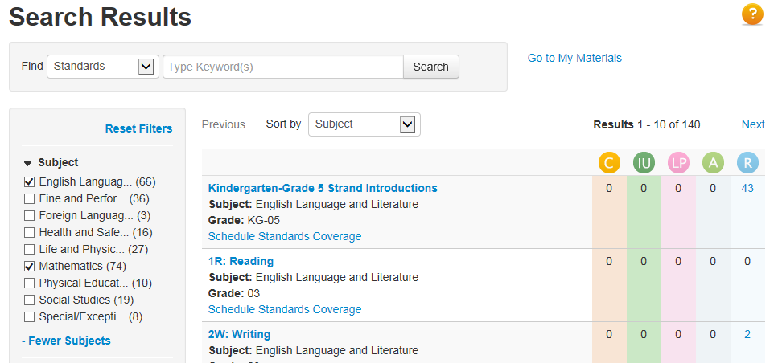
Standards Search
Search for standards that contain a keyword
Locate all materials aligned to a standard
Schedule standards on the lesson planner
Be sure to search the appropriate level of the standards hierarchy
Notes:
Not only can you search for materials, but you can also search for standards and see what materials are available for each standard
Be sure to point out that you can only search for one level of the standards hierarchy at a time. Select which level in the bottom left
Use this screen to discuss the different material types—point to icons and then draw out the hierarchy on a whiteboard

