Slide 1
How to Take a Test Online
The next few slides will explain these steps:
STEP 1: Sign In
STEP 2: Enter the online passcode
STEP 3: Answer questions
STEP 4: Check your answers
STEP 5: Review results, if available

Slide 2
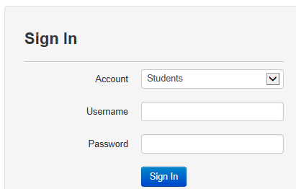
Sign In
Your teacher or another test proctor will provide you with the test site address, your username, password, and an online test passcode.
Notes:
Customization suggestion: add the site URL to this screen
If the computer lab requires a network password, be sure to clarify which password goes where

Slide 3
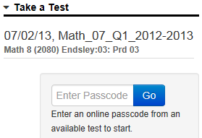
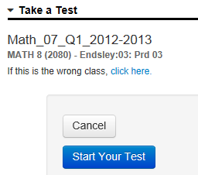
Enter the Online Passcode
Enter the online passcode for the test and click Go.
Alert your teacher if the wrong class is listed
Click Start Your Test.
3
Notes:
Once you sign in, enter the online passcode.

Slide 4
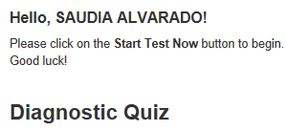
Confirm and Start
Confirm that the welcome message displays your name and the correct test name, then click Start Test Now.
4
Notes:
You will be taken to the “test tunnel”

Slide 5
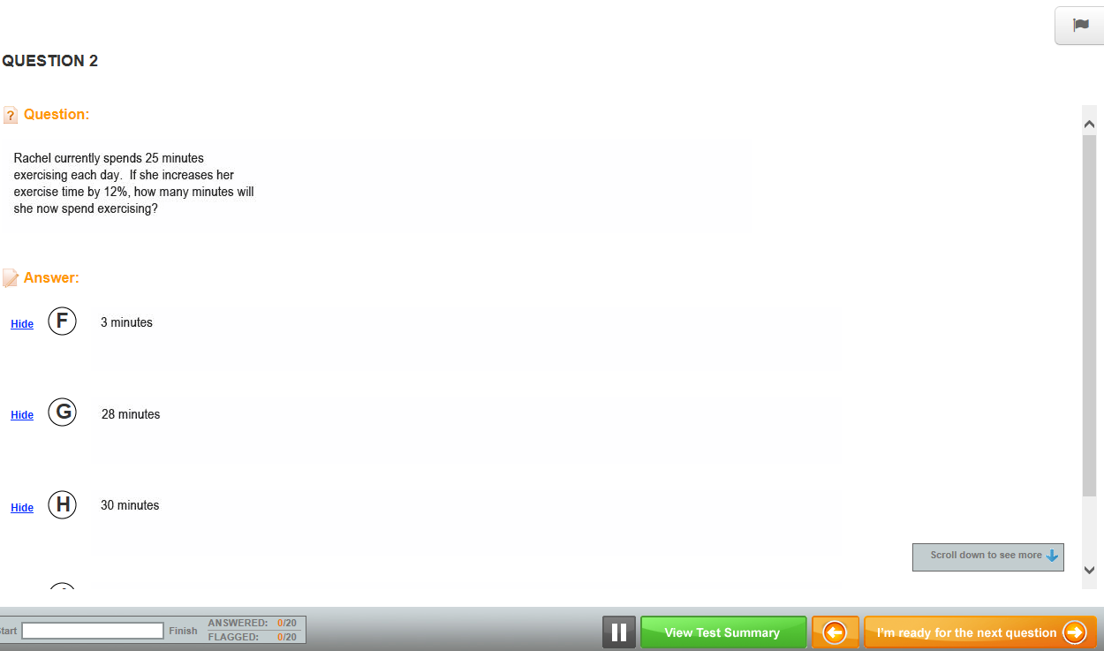
Test Navigation and Strategies
Click the flag icon to tag questions you want to review before submitting.
Click Hide for any answer options you want to eliminate.
Click the scroll bar to scroll down the page.
Click this button to move to the next question.
Notes:
You may encounter a variety of question types. You can “gray out” (Hide) answer options that you are sure are incorrect. If you aren’t sure about your answer choice, flag the item to review later if you have time.
- Let students know if pause button is available

Slide 6
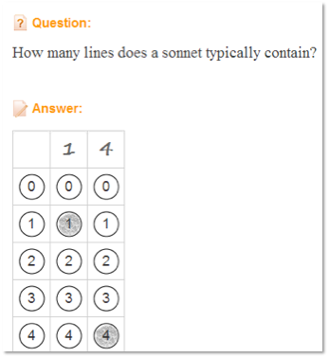
Gridded Items
Notes:
Sometimes you may see what are called “gridded” items. Either click the numbers in the bubble or click in the square at the top of the column to type in the value. You may be given more columns than are needed for the correct response. If you have extra columns, it doesn’t matter if your answer starts at the left side or is flush with the right side.

Slide 7
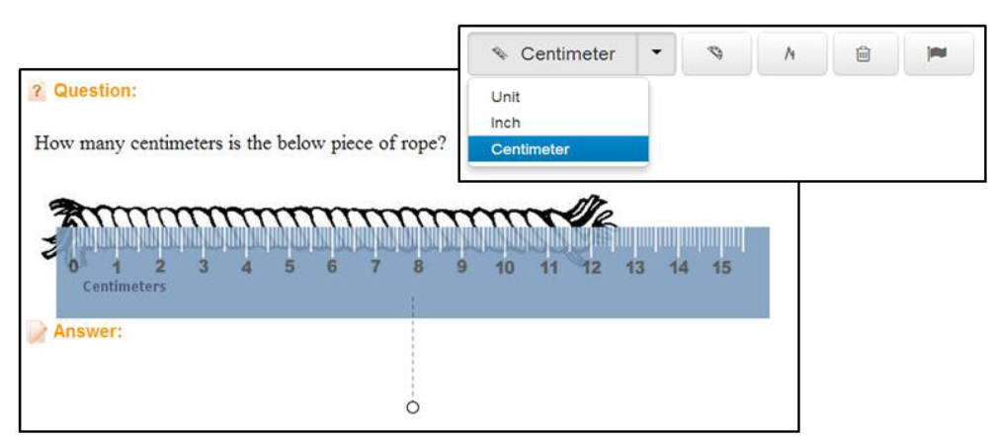
Math Tools
If available, use the math tools provided to help you answer questions.
Notes:
Some math tests will include an online ruler, protractor, compass, and calculator. Click each tool icon to use it.
Note: Manipulatives are not supported on the Safari 5 browser. Mac users can use Safari 6 or Google Chrome.
Clear - Clears all drawing marks from the screen. For the iPad, an additional icon for highlighting text in passages is available.
The clear and flag buttons are always available. May see other math tools as well:
Ruler - There are three rulers: an inch ruler, a centimeter ruler, and a unit ruler (a ruler without a labeled unit of measurement). To move the ruler, click and drag it. To rotate it, click the small circle below the tool and move your cursor.
Protractor – Moving the protractor is the same as moving the ruler.
Compass – The compass is the only manipulative that students can use to make marks on their screens. Students can clear the marks by clicking Clear on the toolbar.
Calculators: 4 Function, Scientific and Graphing

Slide 8
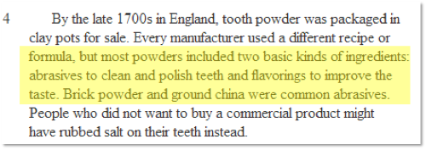
Items with Passages
Sometimes, multiple items will refer to one or more reading passages, diagrams, images, or charts
You may need to use the scroll bar to see everything
As you view the passage, click and drag your cursor over any important parts you want to highlight in yellow
Notes:
Items with passages have a split screen. If the passage is longer than the screen, use the scroll in the center to scroll through passage content.
Questions relating to the passage display on the right or bottom.
For the iPad, an icon for highlighting text in passages is available.
Items with passages have a split screen. If the passage is longer than the screen, use the scroll in the center to scroll through passage content.
Questions relating to the passage display on the right or bottom.
It may be helpful to highlight important information in the passages as you answer questions. If you wish to highlight text in yellow, click the highlighter and then: - On a PC, place your cursor at the start of the text you want. Left-click and hold down your cursor, drag the cursor over the passage you want to highlight, then let go of the cursor button
-.On a Mac, the procedure depends on local settings (for example, may require a ctrl +click)
- Using a trackpad, move the cursor to the beginning of what you want to highlight. With one finger, click and hold down the lower left area of the trackpad. Then with another finger, drag the highlight to include the text you want to highlight. Then raise your fingers from the trackpad.

Slide 9
Open Response Items
For some questions, you’ll type an answer in a text field
Note the word count as you type
A basic formatting toolbar may be available
Notes:
Please note that sometimes your test will include questions that require you to type your answer into the Answer field. Click in the white text box labeled Answer and type your response. A word count shows you how many words you have entered so far.

Slide 10
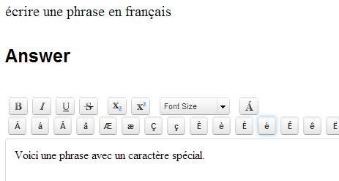
Characters for Foreign Language Responses
For some tests, the formatting toolbar may include a special character button to open a selection of foreign language characters

Slide 11
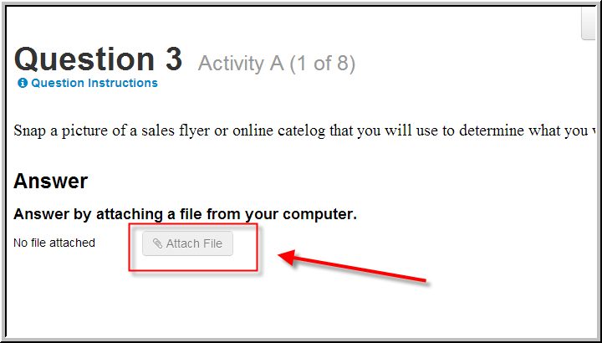
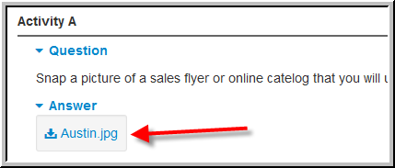
Submit a File
You may be asked to upload a file as your response to an open response question
Max size of uploaded file is 10MB
Notes:
Students can access the file via the student portal after test is submitted
Teachers/Administrators will be able to access the file on the Score page, Classrooms Item Analysis Report light box and Student Profile

Slide 12
Keep Track of Progress
Tests that are timed will have a timer in the top right; be sure to monitor how much time you have left
The box in the bottom left displays your progress
Notes:
Let students know if their test is timed

Slide 13
Troubleshooting Internet Problems
Alert your teacher if you see this symbol on your screen:
The testing platform saves responses whenever you move between questions
Notes:
The red circle symbol indicates that there is a problem with the Internet connection, which can potentially disrupt online testing. Schoolnet Assess has Smart Save features in place to minimize the amount of lost work and maximize system recovery. Because of the Smart Save features listed above, students should not be concerned about losing work if this indicator icon appears during the middle of a test-taking session, as long as it disappears by the end of the test.
A red icon will appear on the top right of the screen if there is a connectivity issue.
Questions are saved each time you navigate to a new item
If icon goes away, students should check work before submitting
If icon stays and internet is down, click Pause button and exit test – will be able to log back in and resume test

Slide 14
Troubleshooting Internet Problems
If at least one or your open response answers could not save, the page displays a warning
Save responses to the system clipboard and then submit the test if you can
If it won’t let you submit the test, sign back in and paste in your work from the clipboard
Notes:
THIS SLIDE ONLY APPLIES IF STUDENTS ARE TESTING ON INTERNET EXPLORER
When the Test Summary page opens during connectivity problems, the system attempts once more to save all student responses. In the event that at least one response from a student could not save, the page displays a warning and the student is presented with the option to save his or her responses to the system clipboard.
If students see this warning on the Test Summary page, instruct them to:
1. Click here in the warning message to save their answers to the clipboard and to allow clipboard access when prompted
2. Attempt to submit the test
3. If the test is accepted, the “test tunnel” will close and the student’s work is complete
4. If students are still unable to submit the test successfully, instruct the students to close the Schoolnet browser window, open a new browser window, then sign in to Schoolnet again
5. Paste in answers from clipboard

Slide 15
Review and Submit
Use the Test Response Summary to access unanswered or flagged items
Be sure to submit your test when you are done
Notes:
Blue = answered
Orange = unanswered
Flag = identified for follow-up

Slide 16
Confirm Submit
Notes:
Click Yes to confirm that you wish to submit your test

Slide 17
Close Test
Notes:
After you confirm the submit, click Close Test.
Students will not have access to view scores.

Slide 18
Review Your Results
Depending on the test settings, you may see your results when you submit the test
Note that points for any open response questions are not yet included; your score is not final until those items are graded
If item-by-item results are made available to you, access them on the same screen where you entered the online test passcode
Notes:
Results may also be available after all classes are finished testing. Sometimes you will be able to view the item content along with your answer.

Slide 19
Student Self-Assessment
Some tests provide you the opportunity to let the teacher know what score you think you deserve on open ended questions
After you submit a test, return to the home page to locate the test and click Self-Assess
For each item, review your answer and then either type in a score in the field provided or read the rubric and select the most appropriate score button
Notes:
After the teacher scores the items, you can compare scores when you review results

