Slide 1
What is Curriculum Manager?
State and district curriculum managers can create, copy, edit, upload and publish valuable curricula. If you are provisioned with the manage curriculum operation
All material is delivered to a private repository where curriculum managers can review and update the material before sharing.
Once material is active it becomes available to all associated districts and schools through Classrooms instructional materials search it can also be mapped and/or scheduled to specific courses
No approval flow so makes it very easy to add curriculum

Slide 2
District-level Access
Users with permission to use Curriculum Manager can create materials directly in the District bank.
No approval is required when adding materials.
Notes:
To add curriculum materials, users are assigned District-level access and are given the operation “Manage Curriculum.”

Slide 3
Navigating Curriculum Manager

Slide 4
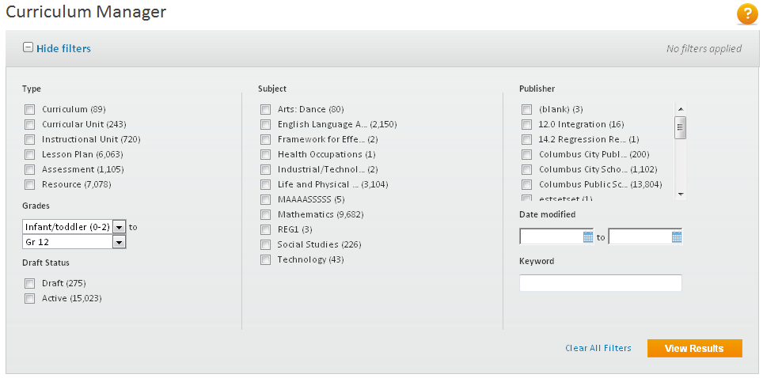
Searching/Filtering for Materials
Use filters to find materials in the District bank.
Search materials by:
Type
Grade
Draft status
Subject
Publisher
Date modified
Keyword
Notes:
When you access Curriculum Manager, you will see the Curriculum filter box. The filter box displays the number of materials that currently exist in your district’s materials bank by material type, grade, draft status, subject, and publisher.
You can filter materials in a variety of ways. You can also search for materials by date modified and keyword.
These filters make it easy to find materials that already exist. In Curriculum Manager, you no longer have to “unapprove” a material in the district bank to be able to edit it.

Slide 5
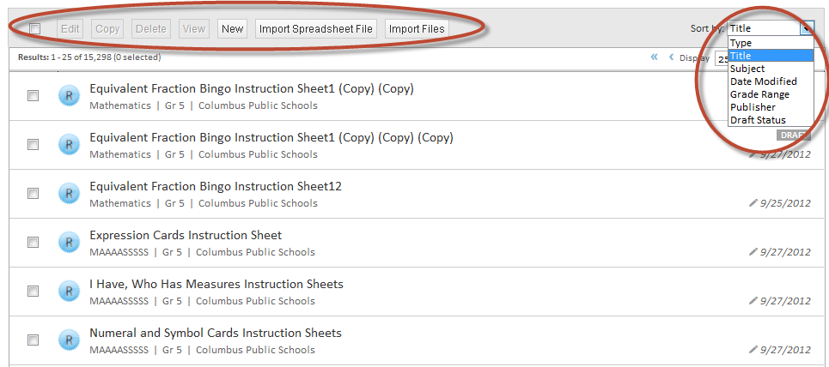
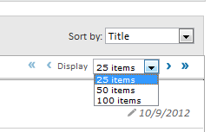
Sorting & Viewing Materials
Notes:
Below the filter box, see a list of materials sorted by title. Use the Sort by menu to sort the materials by type, subject, date modified, grade range, publisher, or draft status.

Slide 6
CURRICULUM STRUCTURE
Curriculum
Language Arts Grade 4

Slide 7
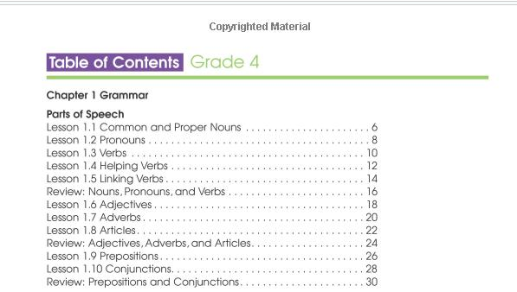
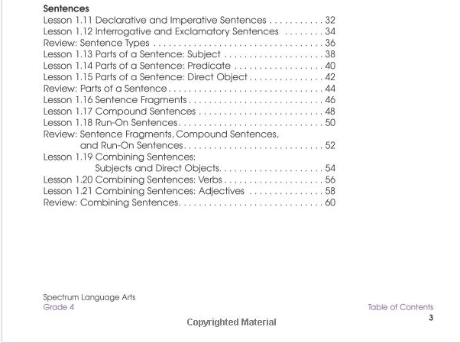
CURRICULUM STRUCTURE
Curriculum
Language Arts Grade 4
Curricular Unit
Chapter 1: Grammar

Slide 8
CURRICULUM STRUCTURE
Curriculum
Language Arts Grade 4
Curricular Unit
Chapter 1: Grammar
Instructional Unit
Parts of Speech
Instructional Unit
Sentences

Slide 9
CURRICULUM STRUCTURE
Curriculum
Language Arts Grade 4
Curricular Unit
Chapter 1: Grammar
Instructional Unit
Parts of Speech
Assessment
Lesson
Review Nouns, Pronouns, and Verbs
Lesson 1.1 Common and Proper Nouns

Slide 10
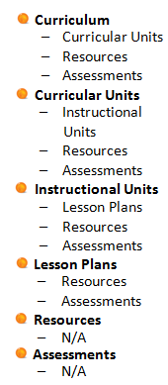
CURRICULUM MATERIALS & RELATIONSHIPS Materials may be “free standing” or linked to other materials
Curriculum
Curricular Unit
Assessment
Curricular Unit
Instructional Unit
Resource
Lesson
Resource
Assessment
Instructional Unit
Lesson
Resource
Assessment
Resource
Notes:
CURRICULUM
Curricular Units
Resources & Assessments
CURRICULAR UNITS
Instructional Units
Resources &Assessments
INSTRUCTIONAL UNITS
Lesson Plans
Resources & Assessments
LESSON PLANS
Resources & Assessments
RESOURCES
NA
ASSESSMENTS
NA

Slide 11
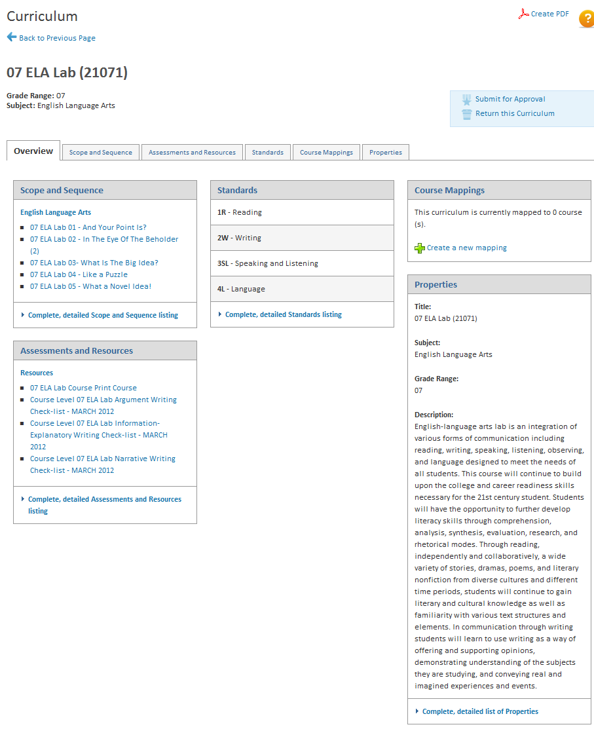
EXAMPLE OF FULLY ALIGNED CURRICULUM IN SN

Slide 12
THREE WAYS OF ENTERING MATERIALS
Copy and paste content into the template fields in Curriculum manager or Instructional Materials
Upload files as attachments.
Create links to materials on external sites

Slide 13
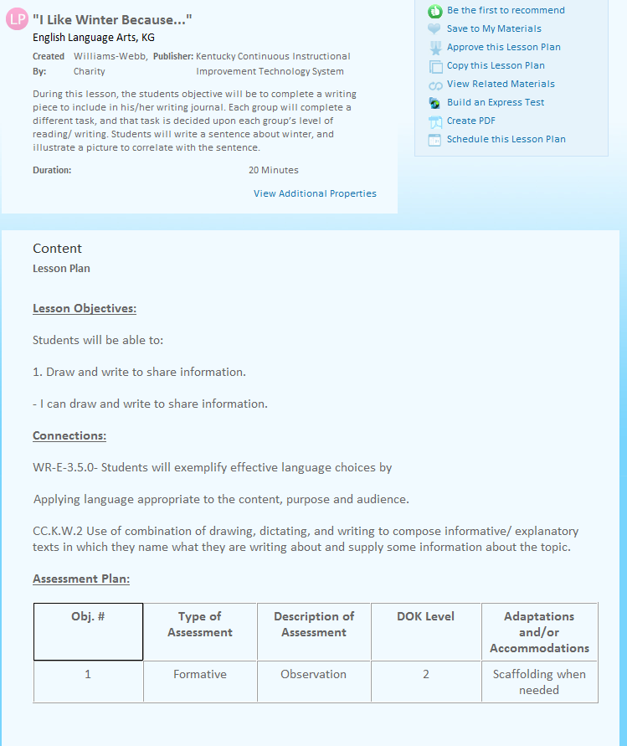
THREE WAYS OF ENTERING MATERIALS
Copy and paste content into the template fields.

Slide 14
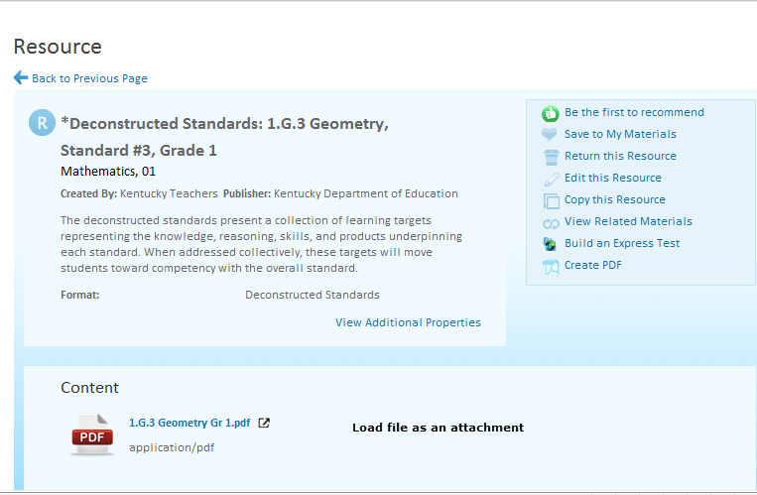
THREE WAYS OF ENTERING MATERIALS
Upload files as attachments.

Slide 15
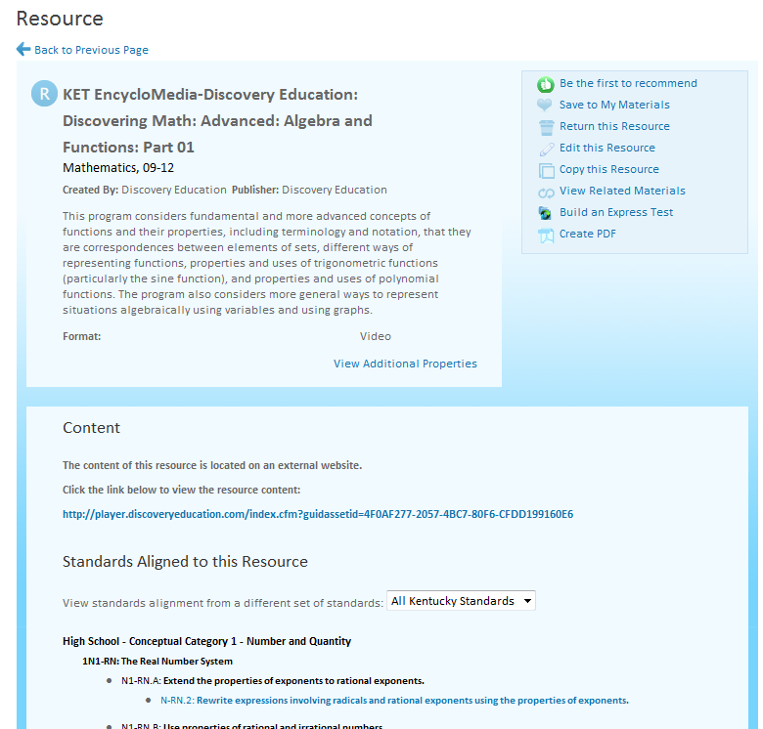
THREE WAYS OF ENTERING MATERIALS
Create links to materials on external sites

Slide 16
CREATE A CENTRAL LOCATION FOR FILES
Create a central location for all subject files. This will save you A LOT of time when you begin loading curriculum into Schoolnet.
Only move files to the central location when they are finalized and ready to load to Classrooms.

Slide 17
CREATE NAMING CONVENTIONS
Naming conventions are needed for:
Folder Structure
Title Naming Convention
Curriculum
Curricular Units
Instructional Units
Lesson Plans
Resources
Assessments
File Naming Convention

Slide 18
NAMING CONVENTION RECOMMENDATIONS
Use the same naming convention across grade ranges and subjects.
Create a naming convention that is easily understood by all.
Be consistent.
Remember the goal is to create an exceptional user experience.

Slide 19
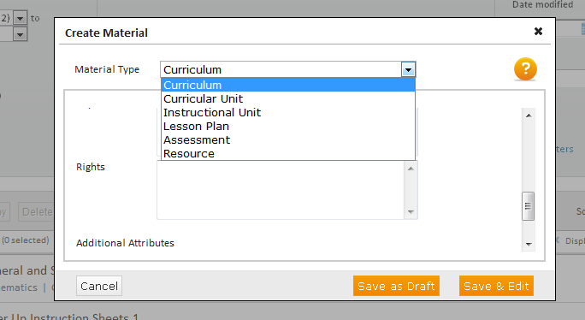
Types of Materials
When creating new materials, you will first select the type of material you want to create.
Choose from curriculum, curricular unit, instructional unit, lesson plan, assessment, or resource.
Notes:
When you click New to create a new material, the Create Material page opens
Select the type of material you wish to create
Then define the properties of the material
For each material type, define the material properties and identify the resource format.

Slide 20
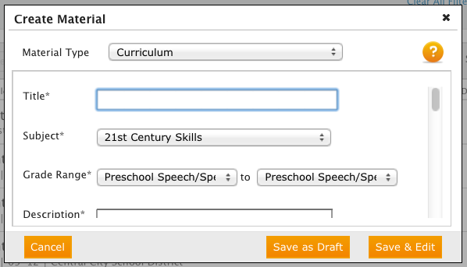
Material Properties
Next, add information that will help you find this item again. Enter a title, subject, grade range, and description.
Notes:
Now enter information that will help you find this resource again.

Slide 21
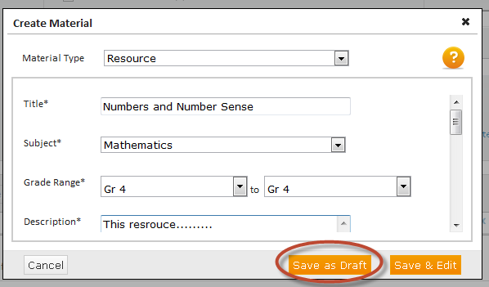
Save Your New Material
Notes:
When you’re finished entering data, click Save as Draft or Save & Edit.
When you click Save as Draft, your item will appear at the top of the list under Created material. The material is there for you to work on at a later time.
You will see a message with a checkmark next to it, which means the material has been created.
To the right, you will see the date the material was created, as well as DRAFT, indicating the status of the material.
Any material that has “draft” status can only be seen in Curriculum Manager. It is not visible in the District bank.
When you’ve finished creating your material and it’s ready for other users to see, change the status from DRAFT to Active.

Slide 22
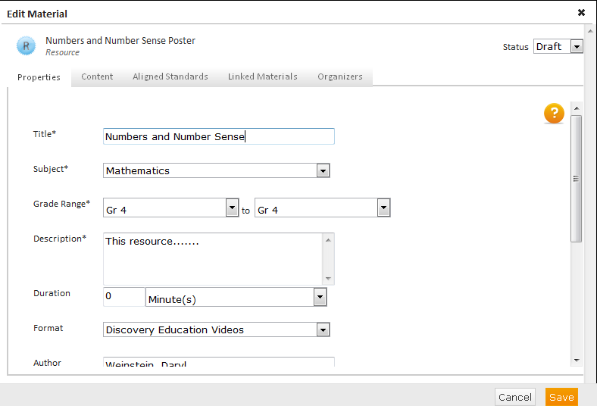
The Properties Tab
Notes:
When you click Save & Edit, the material is also saved as a draft, but you will see the remaining tabs that have to be filled in. Start with the Properties tab. Be sure to open the Format menu and choose a format for your resource.
The number of tabs you see is determined by the type of material you are creating.

Slide 23
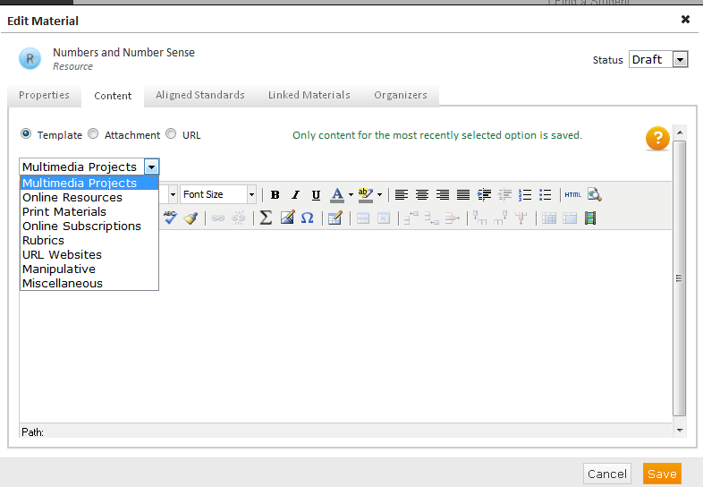
The Content Tab
Notes:
Enter content in a variety of ways. You can use a template, enter content directly into the text box, upload a file as an attachment, or link to a URL. Use the menus within the Content tab whenever possible.
This HTML Editor is the same as the one that is available in Assessment Admin.
Do the following using the HTML Editor:
Formatting options
Math/Science equation editor
Include images
Table formatting options
Paste from Word

Slide 24
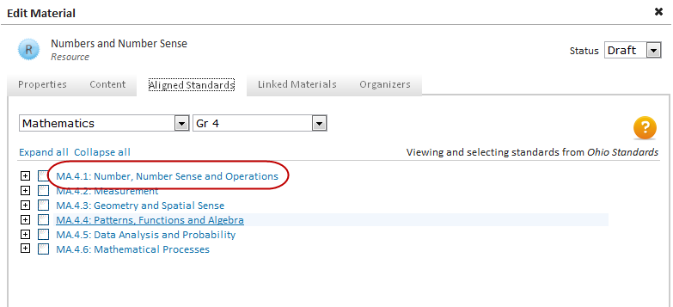
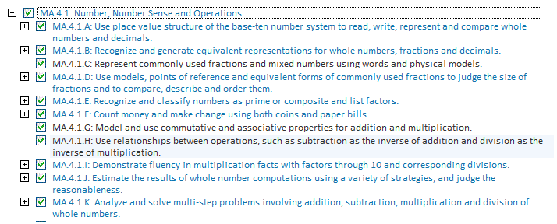
Aligning Materials to Standards
Notes:
Select the Aligned Standards tab and align your new material to standards. Expand the levels of standards until you find the standard you want. Keep in mind that you cannot align curricular units to standards.
You can choose whether or not to align your new materials to standards.
Click the Standards tab and the Standards page appears
Expand the levels to see the lower level standards. To collapse the levels and see the higher level standards, click the Collapse all link.
To select all the standards in a tree, double click the standard link to the right of the checkbox
You can uncheck standards individually, or you can uncheck all standards in a tree by double clicking the standard link again

Slide 25
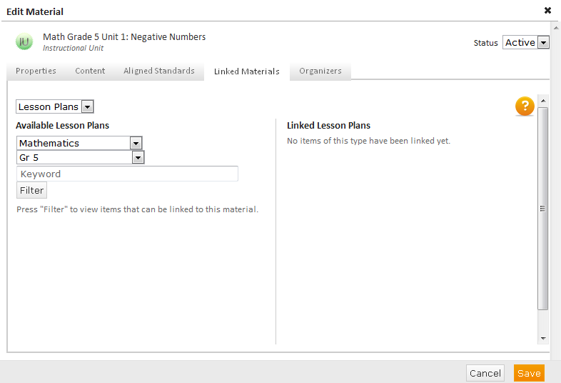
Linking Materials
Select the type of material you wish to link; the list changes based on the type of material you are working on
Filter by subject, grade, or keywords
Click Filter
Notes:
To link materials, both must already be created. Search for and find the two items, then click Save to link them.
This functionality differs from linking material on the site where you have the option of creating a new material.
Rule of alignment: you can align down.

Slide 26
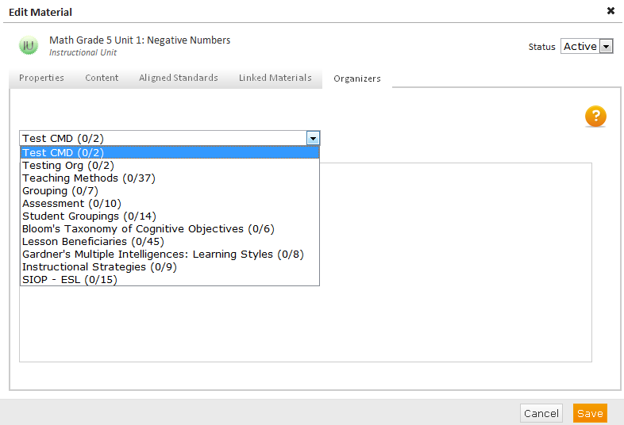
Adding Organizers
Notes:
Last is the Organizer tab. To find existing materials more easily, add tags, or organizers. Organizers sort materials into categories such as Teaching Methods or Cognitive Objectives. Later, search by organizers to find materials more quickly.
To add organizers:
Click the Organizers tab
Use the menu to select the category of organizer you wish to view
3. Select organizer(s) by checking the box(es) next to the corresponding item(s)
4. When you’re finished, click Apply
5. To save your changes, click Save.

Slide 27
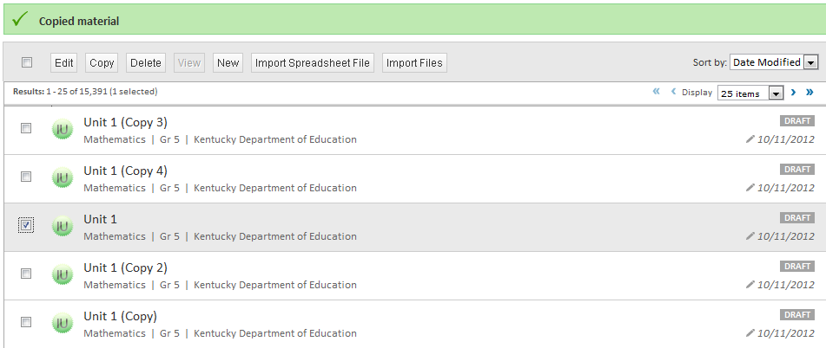
Copying Materials
To copy materials, use the filters to find the item you want to copy, select it, and click Copy.
The same item name appears with the word “Copy” next to it.
Notes:
Use this feature when you want to quickly make shells of the same material type
Select the material you want to copy by clicking the box next to the material name
Click Copy. The copied materials will have the same name as the original with the addition of the word (Copy) next to it.
A good use of the copy feature is if you want to quickly create shells for the same material type. For example, say you want to create five Instructional units for Mathematics grade 5. Since you know that most of the fields on the Properties tab will be the same (subject, grade, author, publisher, rights) the most efficient way to create these units is to create one unit, filling in all the fields on the Properties tab that will be the same, and adding an example title and description, knowing you will come back to each material and edit the title and description fields. Once you have completed the Properties tab, click Save as Draft.
If you make additional copies of the same material, each copy will have a number after it (Copy 2, Copy 3, etc.).

Slide 28
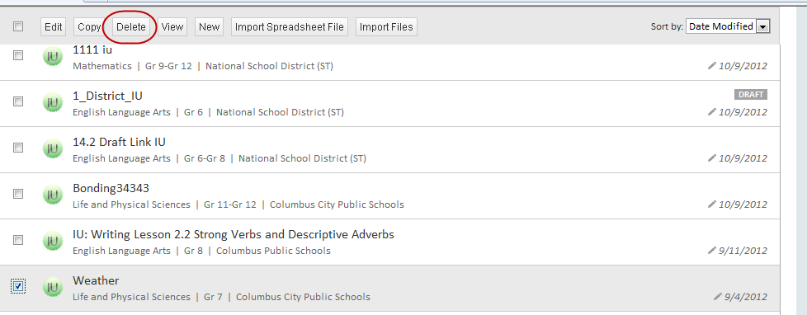
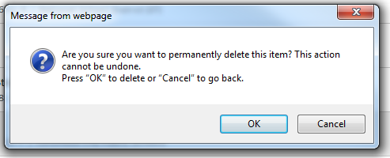
Deleting Materials
Notes:
To remove an item from the District bank, select the item and click Delete. You will be asked to confirm that you want to delete the item.
If you don’t want to remove the item completely, change the status of the item to “Draft” and it will be removed from the bank but not deleted.

Slide 29
Editing One Item
To edit one item, use the filters to find the item, click View Results, select the item, and then click Edit.
Notes:
Use filters to locate the material(s) you want to edit
Click View Results to see your results list
Select the material you want to edit from the results list by checking the box next to the material name
Click Edit
When you click a checkbox next to a material name, the box around that material turns gray.

Slide 30
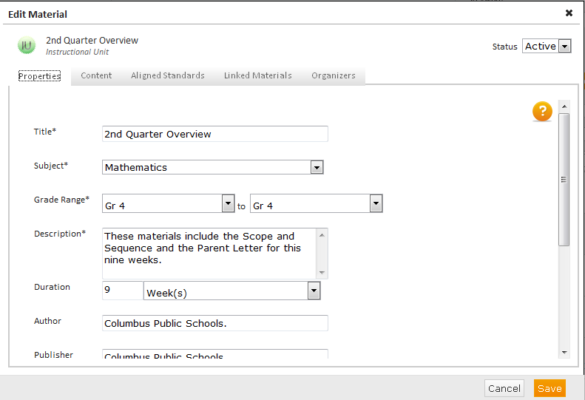
Editing One Item
Notes:
When you click Edit, the Edit Material page appears, giving you access to the same tabs that you saw when you created a new material.
Make changes as needed to this edited material and click Save.

Slide 31
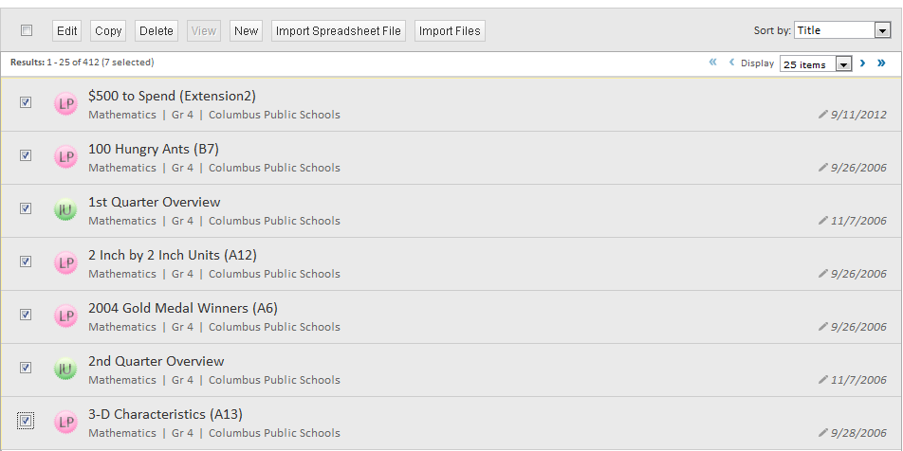
Editing Multiple Materials
Notes:
Use this feature to make mass changes to any of the fields on the Properties tab
Select multiple materials of different types to edit at the same time
Find the materials you want to edit by using the filters you saw earlier
Click the checkboxes next to the appropriate material names and click Edit
To select all the materials at once, click the box next to Edit.

Slide 32
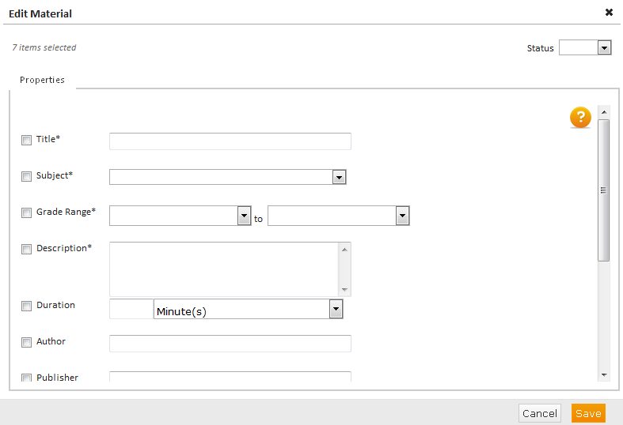
Editing Multiple Materials
Notes:
When you click Edit, you will see a blank Properties tab page
Make changes to the fields on the Properties tab and apply the changes to all the materials you selected
When you’re finished making changes, click Save
This functionality is often used to make changes to the Author and Publisher, Grade range, and Publisher fields.
You can also fix any errors on the Properties tab. For example, if you entered All Rights Reserved in the Keywords field instead of the Rights field, delete the words out of the Keyword field and click Save.

Slide 33
Importing Materials

Slide 34
Importing Existing Materials
There are times when you want to import existing materials.
On the Curriculum Manager home page, click Import Files.
Notes:
Instead of creating new materials, import existing materials. On the Curriculum Manager home page, start by clicking Import Files. Then select the material type, grade range, and subject for the item you want to import. When you’re finished, click Next.
Click Import Files
Select the material type you wish to create, the grade range, and the subject for the files you want to import
Once you have made you selections, click Next

Slide 35
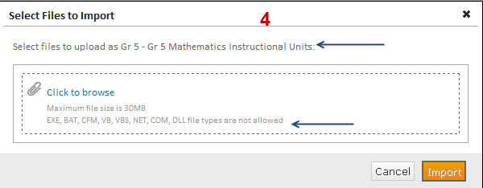
Importing Existing Materials
Notes:
To find the file or files you want to import, select Click to browse. Be sure to make a note of the file types that are not supported.
Select the files you want to import by clicking the Click to browse link.
Under the link, you will see a list of files NOT supported.

Slide 36
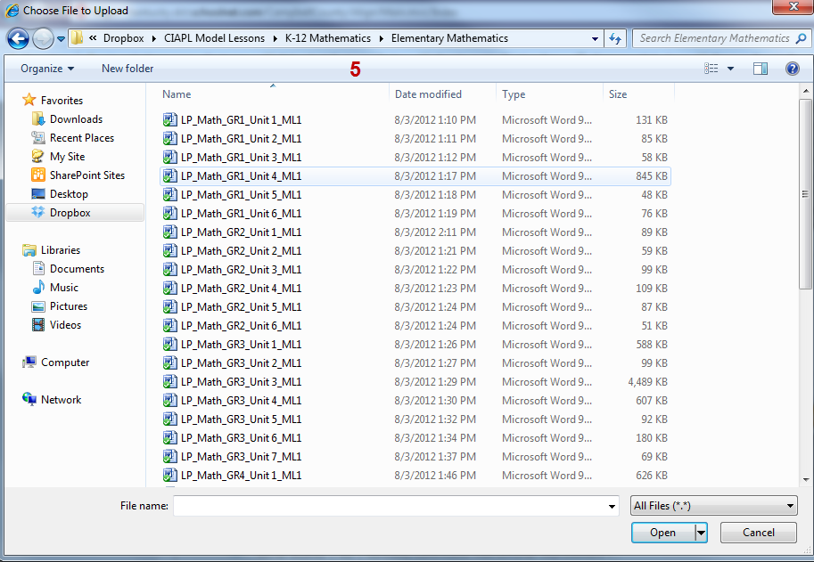
Importing Existing Materials
Notes:
Navigate to your files and select the file or files you want to import. Be sure to select the files one at a time. When you’re finished, click Open.
Once you click Next you will be taken to the directories on your computer.
Navigate to the file(s) you want to import
You must select each file one at a time

Slide 37
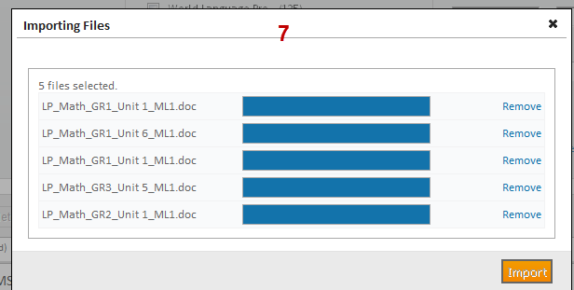
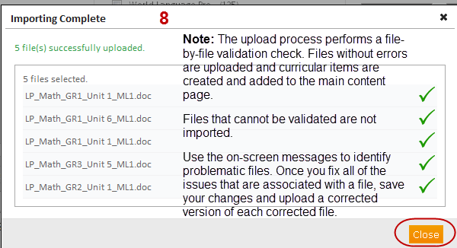
Importing Existing Materials
Notes:
You will see an import progress screen with a list of all the files you selected to import. Next to each of the file names, you’ll see a progress bar.
As the files finish uploading, a green check mark appears next to each file name.

Slide 38
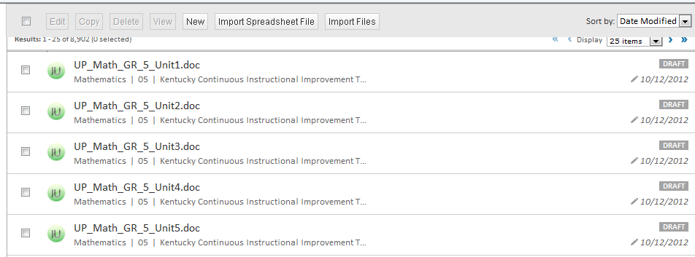
Importing Existing Materials
The imported materials are listed at the top of the list
Materials are imported with the information you supplied
Imported materials have a “draft” status
The item title is the item file name
Notes:
Once the files have finished importing, you will see the green status bar on your screen.
The materials you created will show at the top of the materials list.
All materials import with your pre-defined selections, and they all import as drafts.
The material titles import as the file name.

Slide 39
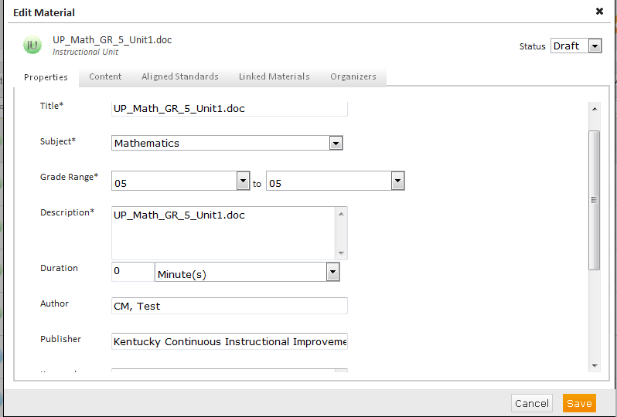
Importing Existing Materials
Last, complete these steps:
Add the properties information
Align the item with standards
Link materials as needed
Add organizers, or tags
Notes:
Fill in the appropriate information on each tab the same way you did when you created new materials. Then, click Save.
Your last steps are to:
Complete the Properties tab
Align standards
Link materials
Assign organizers (tags)
This is where you might want to use the Edit multiple materials feature.

Slide 40
Importing Spreadsheets
Import multiple spreadsheets at once
to bulk upload large numbers of the same material type
Fill in the Properties tab once for all spreadsheets
Load spreadsheets using URLs
Notes:
Use this feature when you want to import several spreadsheets at once.
Use the import spreadsheet feature to bulk upload large numbers of the same material type at one time
With this functionality, you can complete the Properties tab for multiple materials
You can load materials as URLS

Slide 41
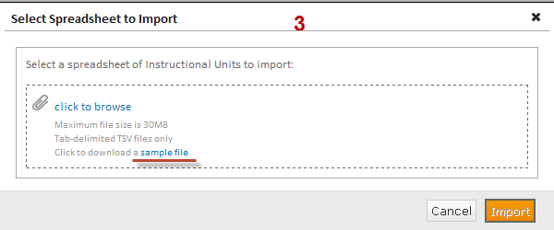
Importing a Sample File
Click Import Spreadsheet File
Select the type of material you want to import and click Next
Click Sample File
Notes:
Follow these steps to import the sample file.
Click Import Spreadsheet File
Select the type of material you want to import and click Next
Click the link sample file to download a sample file

Slide 42
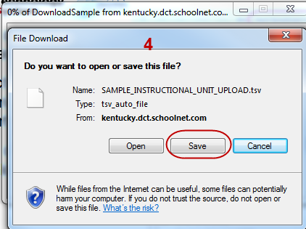
Importing a Sample File
On the File Download screen, click Save and choose a location where you will save the sample file.
Notes:
Save the sample file to your system.
The example upload file will download and you will be asked to open, save, or cancel it.
TSV files are tab delimited text files. The easiest way to work with them is to open them in Excel.
Click Save and choose a location where you will save the file.
Go back and click Cancel on the Select Spreadsheet to Import screen to close it.

Slide 43
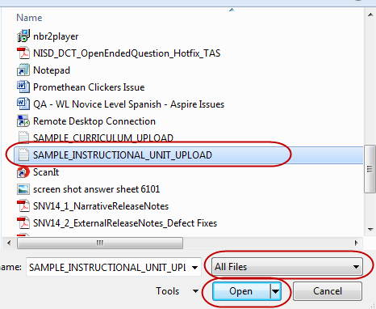
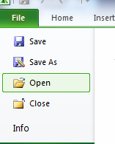
Open the Sample File
Launch Excel
Open the File menu and select Open
For the tile type, choose All Files
Select the sample file and click Open
Notes:
Now launch Excel and open the sample file.
Open Excel
Click on File > Open
Select All Files
Locate the sample file and click Open

Slide 44
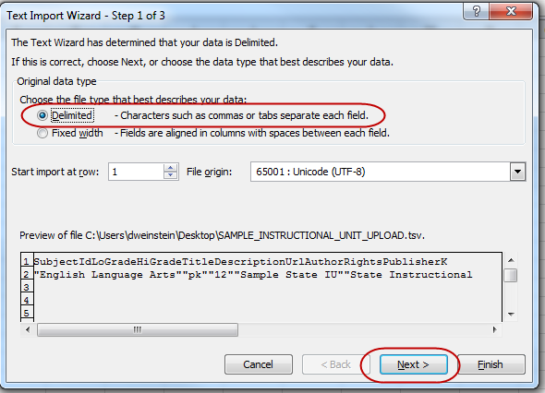
Using the Text Import Wizard
When the wizard launches, leave Delimited checked and click Next.
Notes:
Once you click Open, you will see the Text Import Wizard screen
Leave Delimited checked
Click Next

Slide 45
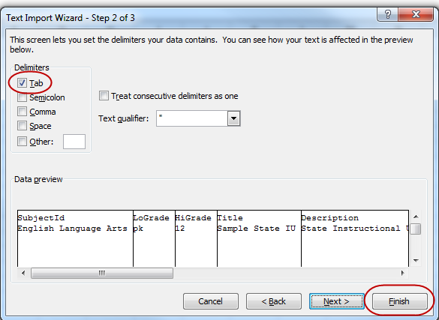
Using the Text Import Wizard
Leave Tab checked and click Finish.
Notes:
Leave Tab checked
Click Finish
You should see the data in columns
Now you are ready to begin populating the bulk upload file.

Slide 46
Populating the Sample File
Fill in the required fields:
SubjectID – subject of the material
Lograde – the low number of the grade range
Higrade – the high number of the grade range
Title – name of the material
Description – description of the material
Notes:
Now fill in the required information. Do not change the the order of the fields or the formatting.
Required fields:
SubjectID = the subject name that appears on your site
Lograde-higrade - grade range of that material. If it is only for one grade, then the lograde and higrade would be the same number.
Though it’s optional, fill in the additional fields that are appropriate for your material. You should fill in the Author and Publisher fields.
If your materials have a duration, make sure to add it.
Duration field - you can only enter whole numbers
Duration type - choices are minute, day, or week
Rights - you can enter a copyright statement here, such as “All rights reserved”
Keywords - 500 character limit. Words must be separated by a comma.
Cost - mostly used for publisher material - to leave unchecked on the site, enter FALSE
Restricted - mostly used for publisher material - to leave unchecked on the site, enter FALSE
Standards – it is much easier to align standards in Curriculum Manager. Leave blank. If you want to add standards, you must use the standard nomenclature that is used on the site. This may differ from how you would normally write the standard.
You can add materials of the same type but for different subjects and grades in one file.

Slide 47
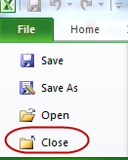
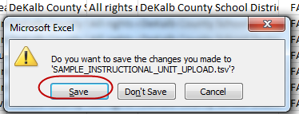
Close the Sample File
Close the file by clicking File and then Close, or click the x at the top right corner
When prompted, click Save
Notes:
When you have completed populating the bulk-upload file, click File and then Save
Close the file by clicking File > Close, or you can click the X at the top right of the screen
Click Save

Slide 48
Close the Sample File
A message may appear that says, “Filename.tsv may contain features that are not compatible with Text (Tab delimited). Do you want to keep the workbook in this format?”
Click Yes.
Notes:
You may see a Microsoft Excel dialogue box that says “Filename.tsv may contain features that are not compatible with Text (Tab delimited). Do you want to keep the workbook in this format?”
Click Yes

Slide 49
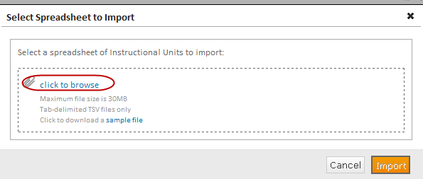
Importing Spreadsheet Files
Click Import Spreadsheet File
Select the type of material you are uploading
Click Next
Select the “click to browse” link to find the TSV file
Notes:
Now you’re ready to import your spreadsheet files.
Click Import Spreadsheet File
Select the type of material you are uploading
Click Next
Click the “click to browse” link to find the tsv file

Slide 50
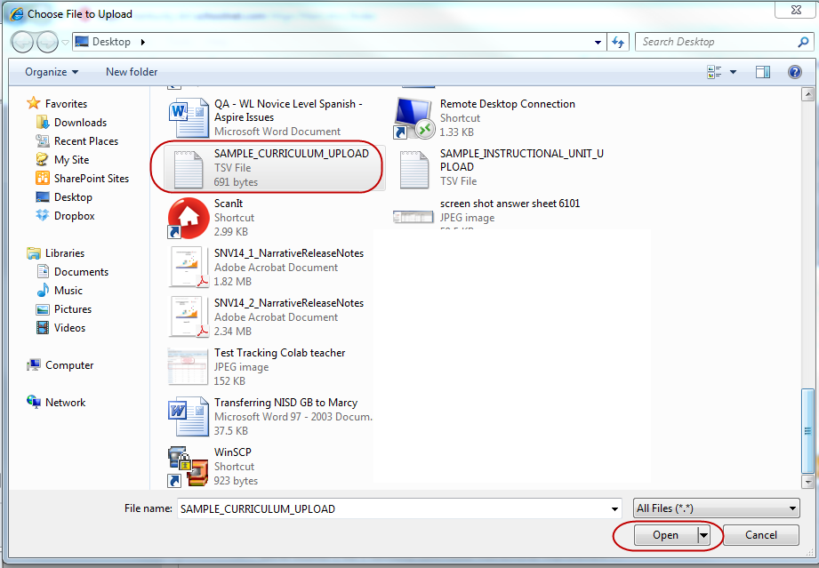
Importing Spreadsheet Files
First, select the file you want to import and click Open.
The Select Spreadsheet to Import screen will list the file you selected.
Click Import.
Notes:
The Explorer window appears
Locate the TSV file you want to upload and click Open
The Select Spreadsheet to Import screen will show the file you selected
Click Import

Slide 51
Importing Spreadsheet Files
Notes:
Watch the progress as your files are imported. As files are uploaded successfully, you’ll see a green check mark next to the file name. Then, click Close. You know that your spreadsheet imported correctly.
A progress screen will appear
When the upload is complete, you will see the progress bar change to a green check mark, and you will see the message “Spreadsheet successfully imported”
Click Close
You will see “Spreadsheet Imported” on the status bar

Slide 52
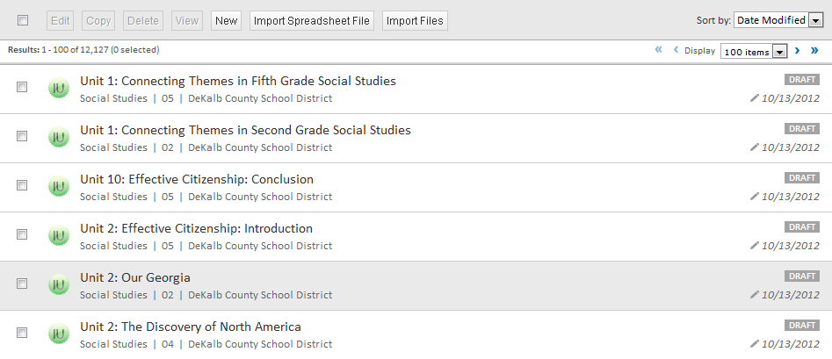
Last Steps
Remember to align the imported spreadsheets to standards
Your imported files will appear at the top of the list
All imported materials have a “draft” status
Notes:
Remember to align the imported spreadsheets to standards!
If your files uploaded correctly, you will see the materials you bulk uploaded at the top of the list.
All the bulk-uploaded materials will have a status of DRAFT.

Slide 53
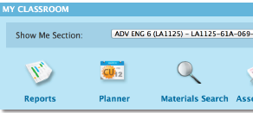
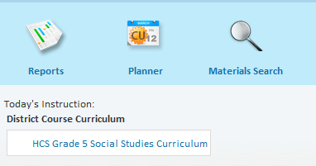
Map Curriculum To Courses
Mapping Courses provide easy access for teachers to get to their courses materials as soon as they login

Slide 54
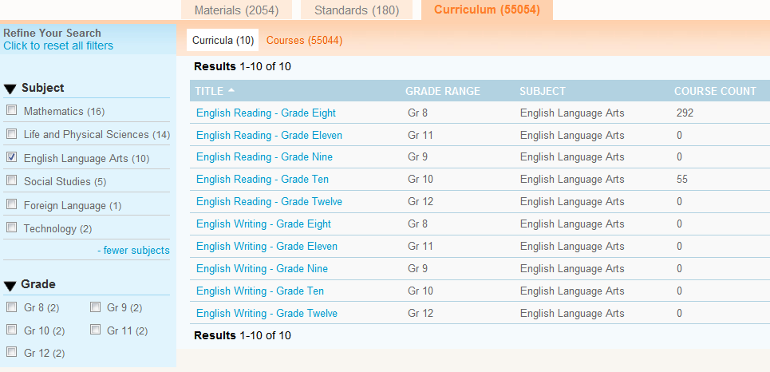
Search for Any Curriculum
From Classrooms>Instructional Materials
Search for Curriculum

Slide 55
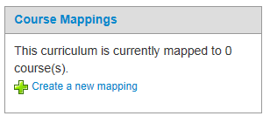
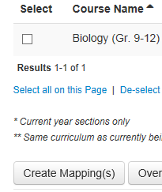
Map Curriculum
Select Curriculum
Select
Select Course and create map

