Slide 1
What is PD Planner?
The Educator Development Solution
PD Planner enables districts and district employees to:
Manage PD course offerings, schedules, locations, instructors, and approval processes
Register online, track credits and recertification, and manage their own PD plan
Track and report PD credits and recertification data at the individual, school, and district level
Align PD to student learning standards, professional teaching standards, school and district improvement goals, and competency frameworks
View site according to role: teacher, administrator, activity facilitator, or system administrator
Notes:
Key Messages
Web-based
Comprehensive solution for managing employee professional development
Aligns PD to district strategic objectives and school improvement goals
Using participation and cost data, helps district analyze return on investment by comparing PD data to student achievement
Highly configurable – you may not be using all the features described
Items to Highlight
Through integration with the other modules in Schoolnet, PD Planner can help districts measure its impact on achievement
Training and employee profile data can assist in recertification (state licensure) and Highly Qualified Educator (NCLB) reporting

Slide 2
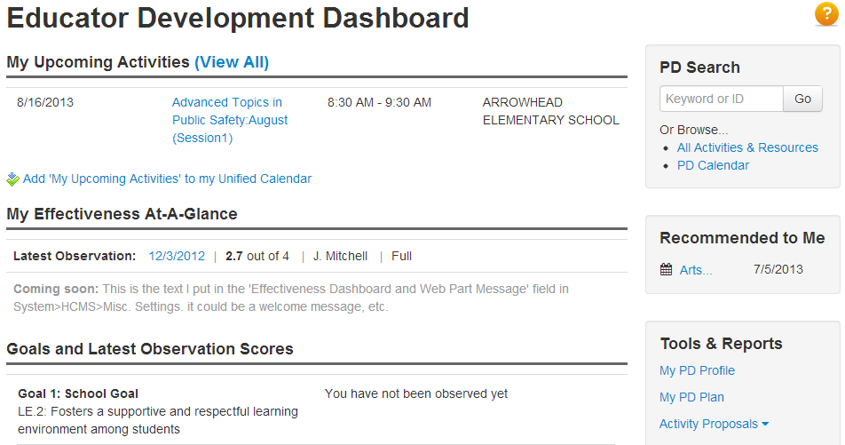
Navigate in PD Planner
Click Educator Development to access a dashboard of shortcuts
Available links vary by role
Notes:
Have users explore the options on their dashboard. May see upcoming activities, links to evaluations for completed activities, activities recommended by an administrator, etc.
Note – Add to Unified Calendar link only visible until clicked – will show up on My Calendar on the My Schoolnet page if that web part is available

Slide 3
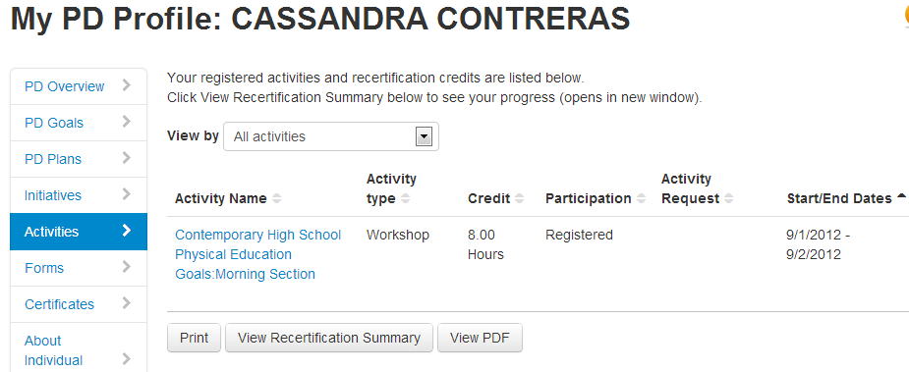
Viewing My PD Profile
Print workshop certificates, recertification summary
View upcoming and past activities
Notes:
Link on dashboard. Give participants time to look at their own profile to see what data is already available.
Recertification guidelines may be available.
Some districts use the profile as a way to have employees check the accuracy of what is in their HR file. Some have developed an error notification process.

Slide 4
Setting Goals
Official goals go into your PD plan and get submitted for approval
Personal goals may be added to the PD Goals tab in the PD Profile
You can locate activities related to those goals and continue to revise as needed.
Official and personal goals may match, but do not have to
Districts implementing the full EDS suite may use Professional Growth Plans (PGPs) instead of the PD plan or PD goal features
Notes:
Note to instructor: Be aware of which of goal options are being utilized (if decision is already made, be sure to communicate)

Slide 5
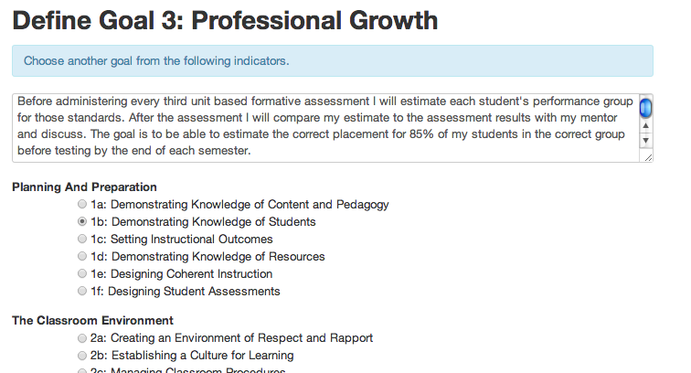
Personal PD Goals
Can align to a standard or content area
Notes:
Note to instructor: Skip if not using
Do not require approval
Can be changed at any time
Can use to find related PD

Slide 6
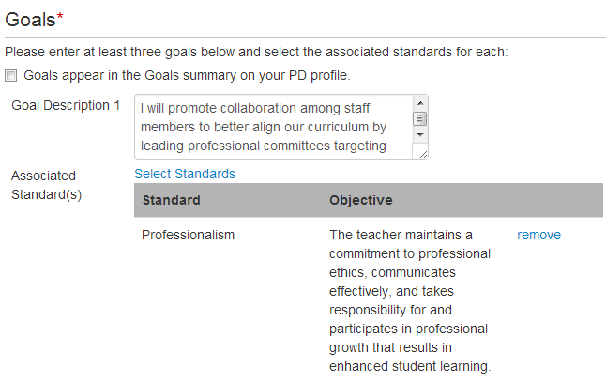
PD Plans
Each goal should be associated with a standard
Notes:
Note to instructor: Skip this slide if not applicable.
In some districts you need a certificate loaded in order to submit a plan.
Number of required goals is configurable.

Slide 7
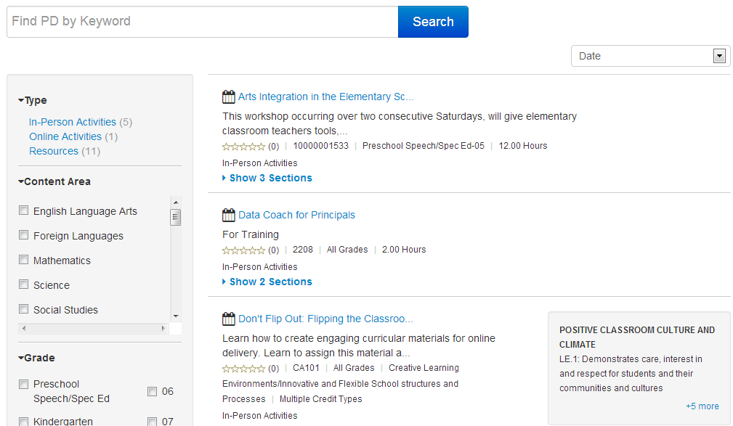
Activity Catalog
Notes:
Locate by keyword, standard, date, and type, among other search options
Demonstrate searching
Give participants time to browse (if the catalog already has items, otherwise demo on training site)
Navigate to this view through search link on EDS home page – demo how to do this

Slide 8
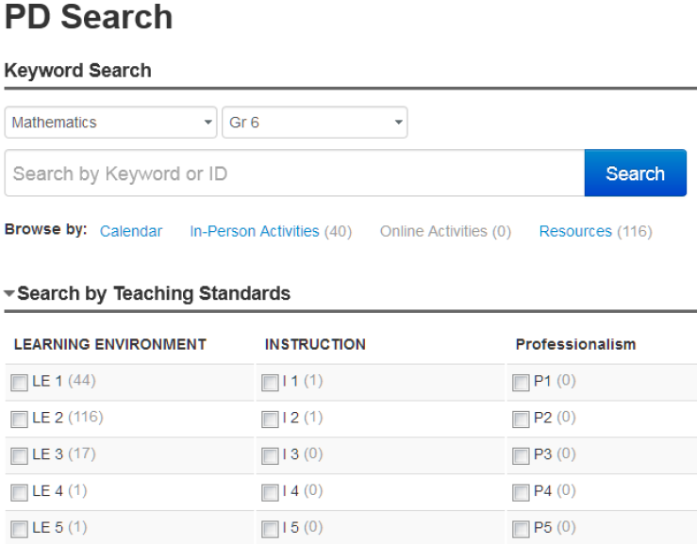
Activity Catalog
Notes:
Contrast this alternate view of activity catalog – get to this layout through EDS sub-menu
Here is the advantage of aligning workshops and resources to PD standards – they are easier to find.

Slide 9
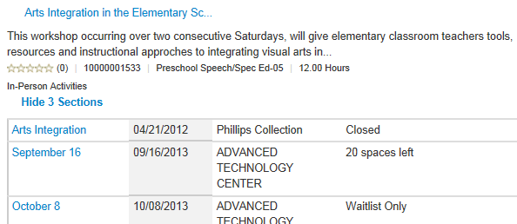
Register for Activities
Register for ‘open’ sections in the catalog
Activities may require approval or have prerequisites
Can be registered or recommended for an activity by someone else
Notes:
When you click on an activity you can see the activity detail and have the option to register. If session is full, can get on waitlist – if a user drops out, first waitlisted user is automatically registered and gets an email (in some districts this feature is disabled).
Some activities my be ‘on demand’ online and not associated with a date.

