Slide 1
What is PD Planner?
The Educator Development Solution
PD Planner enables districts and district employees to:
Manage PD course offerings, schedules, locations, instructors, and approval processes
Register online, track credits and recertification, and manage their own PD plan
Track and report PD credits and recertification data at the individual, school, and district level
Align PD to student learning standards, professional teaching standards, school and district improvement goals, and competency frameworks
View site according to role: teacher, administrator, activity facilitator, or system administrator
Notes:
Key Messages
Web-based
Comprehensive solution for managing employee professional development
Aligns PD to district strategic objectives and school improvement goals
Using participation and cost data, helps district analyze return on investment by comparing PD data to student achievement
Highly configurable – you may not be using all the features described
Items to Highlight
Through integration with the other modules in Schoolnet, PD Planner can help districts measure its impact on achievement
Training and employee profile data can assist in recertification (state licensure) and Highly Qualified Educator (NCLB) reporting

Slide 2
Professional Development Life Cycle
Tracking and reporting PD for both compliance and improvement
PLAN
MANAGE
REFLECT/
EVALUATE
ANALYZE/
REPORT
District
Standards & Goal
Alignment
Course
Management
User
Communication
Evaluation
Summary
Reporting
Data
Import/Export
User Account
Management
Facilitator
Logs
PD/Achievement
Effectiveness
School
School Plan
Summary
School
Approvals
Coach/Mentor
Assignment
Activity
Verification
Reporting
Individual
Online
Registration
PD Reflection
PD Plan
Implementation
Logs
Transcript/
Recertification
PD Approval
Form
PD Evaluation
Notes:
(Depending on audience, may wish to skip this slide)
It may be easiest to think of features in chronological order by role.

Slide 3
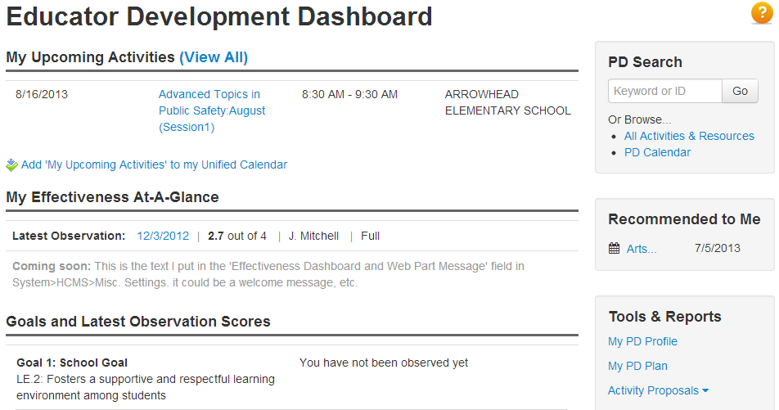
Navigate in PD Planner
Click Educator Development to access a dashboard of shortcuts
Available links vary by role
Notes:
Have users explore the options on their dashboard. May see upcoming activities, links to evaluations for completed activities, activities recommended by an administrator, etc.
Note – Add to Unified Calendar link only visible until clicked – will show up on My Calendar on the My Schoolnet page if that web part is available

Slide 4
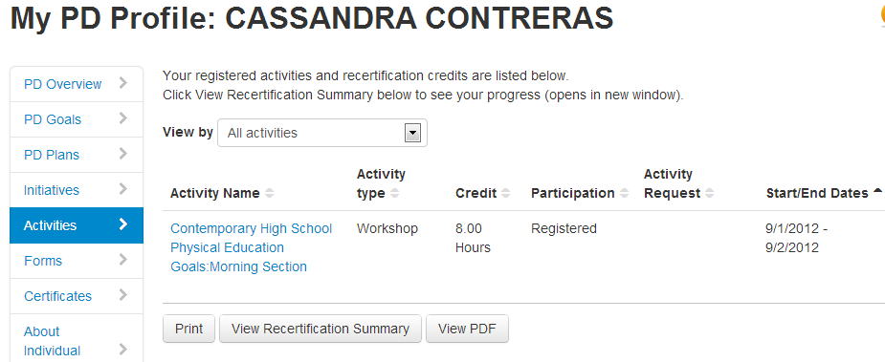
Viewing My PD Profile
Print workshop certificates, recertification summary
View upcoming and past activities
Notes:
Link on dashboard. Give participants time to look at their own profile to see what data is already available.
Recertification guidelines may be available.
Some districts use the profile as a way to have employees check the accuracy of what is in their HR file. Some have developed an error notification process.

Slide 5
Setting Goals
Official goals go into your PD plan and get submitted for approval
Personal goals may be added to the PD Goals tab in the PD Profile
You can locate activities related to those goals and continue to revise as needed.
Official and personal goals may match, but do not have to
Districts implementing the full EDS suite may use Professional Growth Plans (PGPs) instead of the PD plan or PD goal features
Notes:
Note to instructor: Be aware of which of goal options are being utilized (if decision is already made, be sure to communicate)

Slide 6
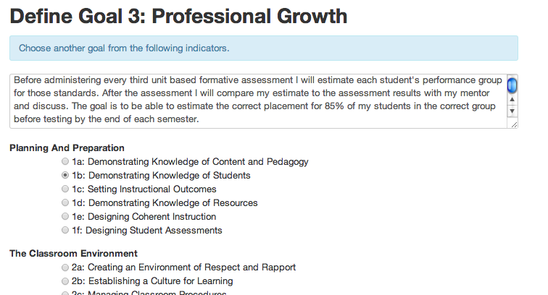
Personal PD Goals
Can align to a standard or content area
Notes:
Note to instructor: Skip if not using
Do not require approval
Can be changed at any time
Can use to find related PD

Slide 7
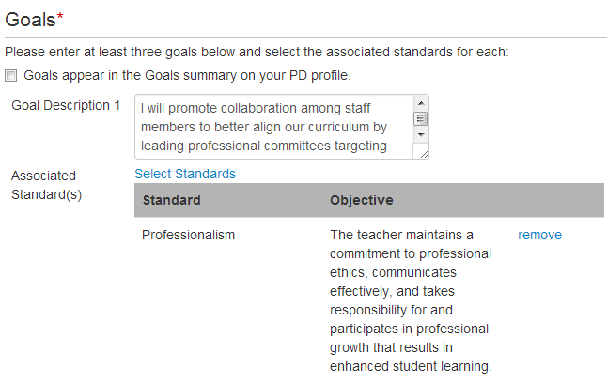
PD Plans
Each goal should be associated with a standard
Notes:
Note to instructor: Skip this slide if not applicable.
In some districts you need a certificate loaded in order to submit a plan.
Number of required goals is configurable.

Slide 8
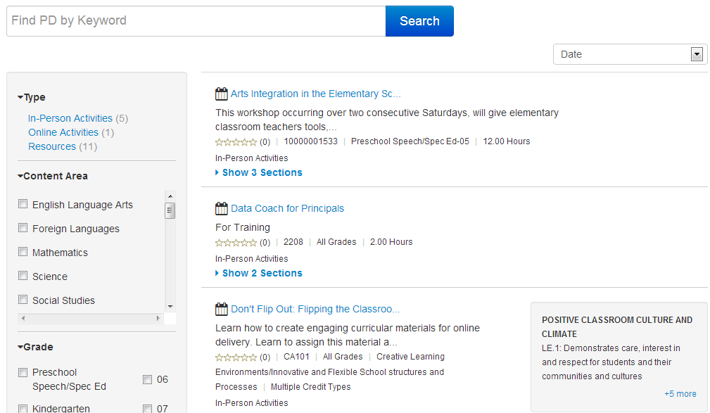
Activity Catalog
Notes:
Locate by keyword, standard, date, and type, among other search options
Demonstrate searching
Give participants time to browse (if the catalog already has items, otherwise demo on training site)
Navigate to this view through search link on EDS home page – demo how to do this

Slide 9
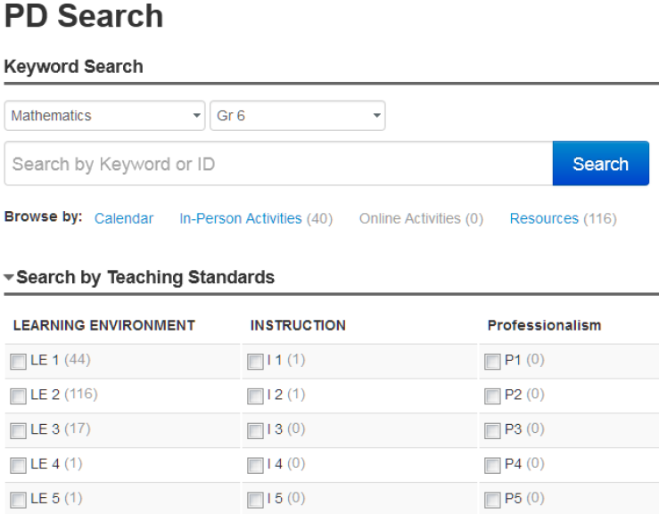
Activity Catalog
Notes:
Contrast this alternate view of activity catalog – get to this layout through EDS sub-menu
Here is the advantage of aligning workshops and resources to PD standards – they are easier to find.

Slide 10
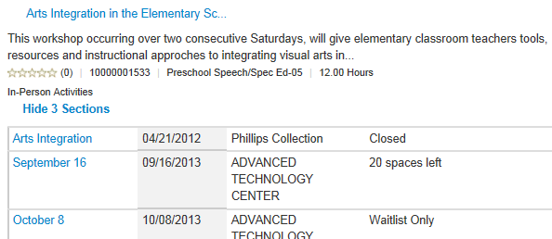
Register for Activities
Register for ‘open’ sections in the catalog
Activities may require approval or have prerequisites
Can be registered or recommended for an activity by someone else
Notes:
When you click on an activity you can see the activity detail and have the option to register. If session is full, can get on waitlist – if a user drops out, first waitlisted user is automatically registered and gets an email (in some districts this feature is disabled).
Some activities my be ‘on demand’ online and not associated with a date.

Slide 11
Important Terms
Activity (Intro to Outreach)
Section (Cohort A)
Session (Part I)
What is one example of a professional development activity given by your department yearly?
How many sections and sessions of this activity are offered each year?
Notes:
Choose some examples from the ice breaker to illustrate these terms. In PDP, you register for a SECTION.
For example, if a college calculus class was held only once per week on Wednesday nights from 6:00 – 9:00:
College Algebra would be the activity.
This particular section of the class was offered from 6:00 – 9:00 on Wednesday nights. Other groups of people might take the same class on Tuesdays in another section.
Each meeting of the class is a session. For a 12-week semester, the section of the class that meets for 3 hours straight would only have 12 sessions, while the section that meets 3 times per week would have 36 sessions.

Slide 12
Requesting Credit and Pre-Approval
Some activities may require pre-approval or approval in order to receive recertification credit
Activity could be internal or external
You may be required to complete a reflection form
Notes:
Not all districts implement requesting credit for external activities.
Pre-approval can be used to
Give example: Teacher goes to a conference or takes a class at local university. He or she may then request that credit be tracked in the PD Planner.

Slide 13
Key Features for Activity Facilitators
View roster of registered participants
Print sign-in sheets
Add walk-in attendees
Submit attendance
Notes:
Depending on configuration, facilitators may not be able to submit final credit.
Users who are tagged as facilitators have an extra tab in their PD Profile with upcoming and past activities.

Slide 14
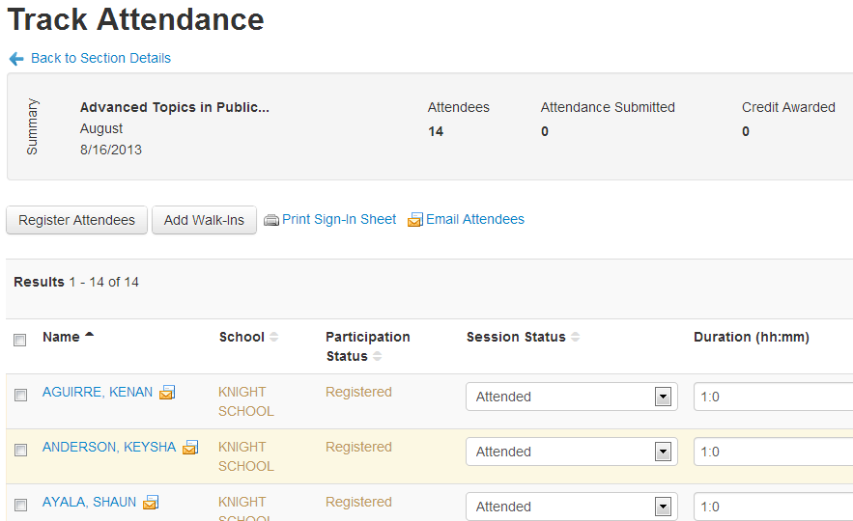
Facilitator’s Attendee List
Notes:
Distinguish between a trainer and the facilitator
Demonstrate what you can do from this screen: register, add walkins, sign-in sheets, email, take attendance.

Slide 15
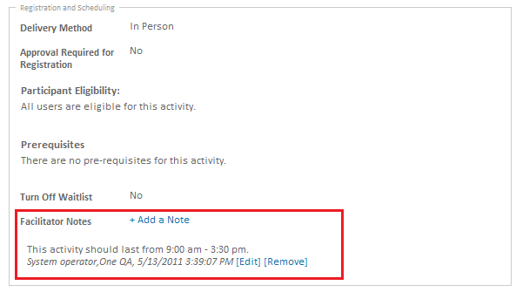
Sharing Facilitator Activity Notes
Facilitators can record notes for an activity. This is shared with other facilitators only, and is designed to foster collaboration and sharing of best practices.
Notes:
This is at the activity, not section level.

Slide 16
How Do Activities Get in the Catalog?
Create an activity
PD administrators can create activities that do not require approval before appearing in the catalog
The activity and sections are created separately
Propose an activity
Any user can propose an activity (unless disabled)
PD administrators must approve the proposal before it appears in the catalog
The proposal is for both the activity and the section
Notes:
Remind participants of difference between a section, session, and activity.
Some districts may choose to disable proposals

Slide 17
Activity/Section Options
Add a form (evaluation)
Make it optional or require it for credit.
Require pre-approval
Pre-approval requirement is useful if the workshop is intended for a particular audience.
Require prerequisites
Note that credit must already be granted on another PDP activity before the user can register.
Add eligibility requirements
Can tie eligibility requirements to job title, but use with caution if job titles are not consistent. As an alternative, use the description field to denote who should attend.

Slide 18
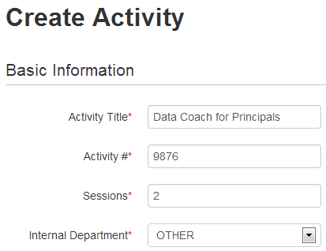
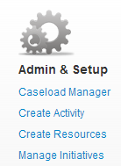
Add an Activity to the Catalog
Notes:
Explain that you should only select Yes for a school-based activity when you want to create a matching section at every single school for a district-wide PD day. (This only appears for district level users.)
Demonstrate how to add an activity. Be sure to talk about the importance of linking it to a PD standard.

Slide 19
Add a Resource
Add one-by-one or upload from spreadsheet
Examples:
Self-directed activities
- Online courses, Moodle LMS integration
Videos of practice
- Intended for videos of exemplary teaching practices Planning tools & tips
- Documents and web resources
Podcasts, lectures, and videos
Learning networks
- Links to web-based communities of practice
Notes:
System operators can create new resource types. Can delete only if no resources are aligned to category

Slide 20
Key Features for PD Administrators
Create and manage initiatives
Approve requests
Approve activity proposals
Tag potential facilitators
Manage mentor assignments
Run reports
Recommend activities
Rights will vary based on permissions

Slide 21
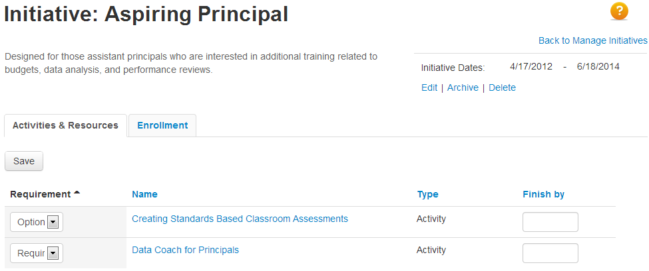
Create and Manage PD Initiatives
Notes:
Use initiatives to group together people who take workshops. You can automatically enroll all members of an initiative to a workshop and tie both workshops and people to initiatives (for instance, principals and nurses).
Ask the group for examples of potential initiatives in their district.

Slide 22
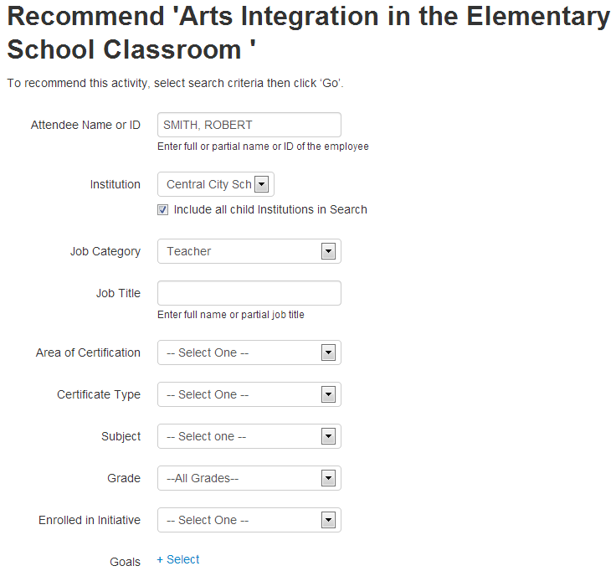
Recommending PD Activities
Administrators can recommend activities. Educators will receive notifications of these recommendations and then may choose to register.
Notes:
Also appears on dashboard.

Slide 23
Approving PD Plans
Who will approve PD plans?
What criteria will you use?
Will you require that a PD Plan be submitted in order for a user to receive PD credits?
Notes:
Show where to view submitted plans. Delete if district not using PD Plans.

Slide 24
Approving Activity Requests for an Individual
Someone must approve participation in activities that are either:
External to the district and require credit, or
Internal to the district but require pre-registration approval
Discuss the activity approval criteria your district uses

Slide 25
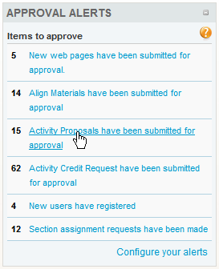
Approval Alerts
May set this Schoolnet home page ‘web part’ globally for all users in the Leadership role
Can be added by each user, although it’s more complicated

Slide 26
Reporting
A variety of reports are available
Export reports to Excel
Each report is pre-set with suggested and optional columns
Save reports to run them again later
Notes:
Demonstrate how to run.
Have participants run a few.

Slide 27
Managing Facilitators
Users are tagged as facilitators in District Profile > Facilitator Settings
Facilitators are assigned when an activity is scheduled
Questions for understanding:
What will the process be setting someone up as a facilitator?
What tasks are facilitators responsible for?
Notes:
State procedure varies – be sure to check ahead of time.

Slide 28
Protocols
May be necessary to implement some best practices surrounding PD Planner
Discuss whether granting partial credit is an acceptable practice
Regarding scheduling: Should people be allowed to register after the open or closed date on an activity?
How long should the window of time be for a facilitator to grant final credit after an activity has taken place?
How far in advance of training dates do proposals need to be submitted?
When should old activities be archived?
Notes:
Some decisions impact configuration (#2), others are policy issues. Information about archiving is in the Admin Guide.

