Slide 1
What is the Educator Development Suite?
Provides teachers with the results of classroom observations and student perception surveys
Suggests contextualized professional development tools to interested teachers
Reports observation scores by school or by teacher to school and district administrators
Allows teachers and schools to set and track goals for improvement
Notes:
Districts need to generate high-fidelity measures of educator quality and performance with both accuracy and fairness. Schoolnet provides a flexible, multiple-faceted approach to the creation of the educator effectiveness ratings, enabling districts to design their own model for measuring educator effectiveness and analyzing data using a series of interactive reports and dashboards.

Slide 2
Framework
Observations are aligned to the framework selected by your district
The framework can be aligned to professional development offerings in PD Planner so that teachers can act upon their observation results
Notes:
Briefly discuss what framework is being used (for instance Marzano or Danielson). Compare to student standards.

Slide 3
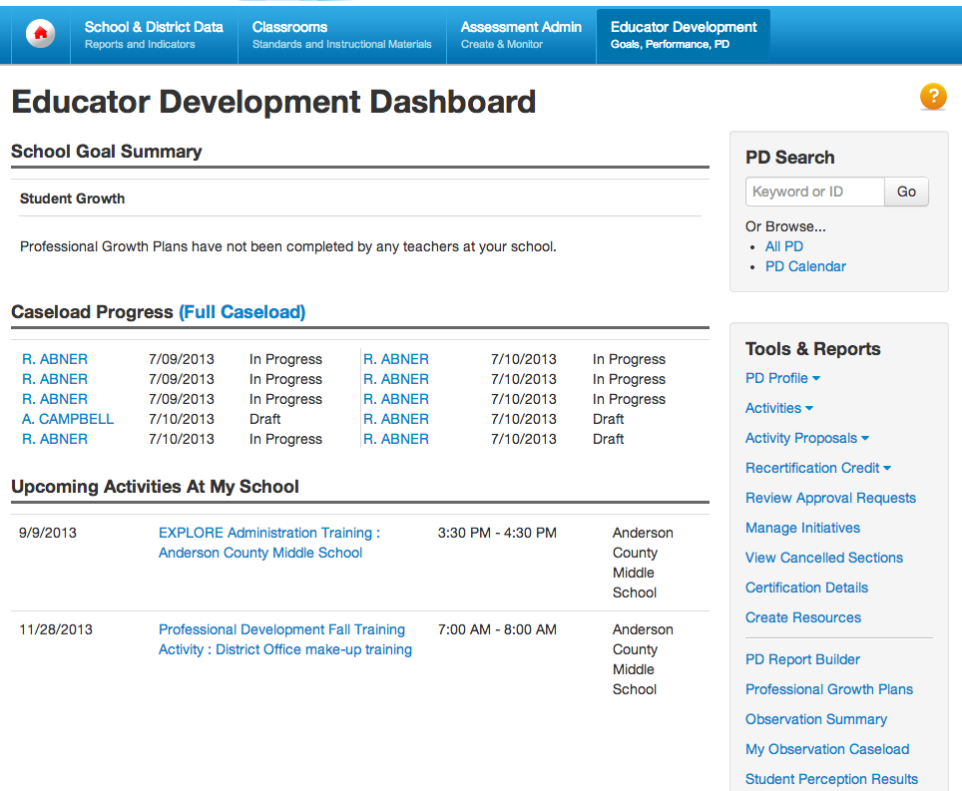
Navigating in EDS
Notes:
Have participants sign in to their site (or a training site if available) and view the EDS home page
Show the difference between rolling over a header and clicking it
The EDS home page includes PD Planner links and is tailored to your role
Point out that system operator can tailor external links and messages
May have a webpart on My Schoolnet home page

Slide 4
Self-reflection
Notes:
Skip this section if not applicable.

Slide 5
Teacher Completes Self-Reflection
Can save in-progress work before submitting
Scoring help may be available
Notes:
Hover over Educator Development and click Self-Reflection under Tools & Reports. If more than one exists, use the drop-down next to Self-Reflection to toggle between them. The labels on this toggle correspond to windows when self-reflections can take place and are not created or configurable by teachers.
Select from drop down and enter notes for each skill. Each skill must be commented on.
Optional: Click Save at the bottom or top of the form to save your changes, but not share it with any other users.
Click Submit Final to submit your self-reflection. You are not able to edit your self-reflection once it has been submitted, and both you and your school leadership will be able to view it.

Slide 6
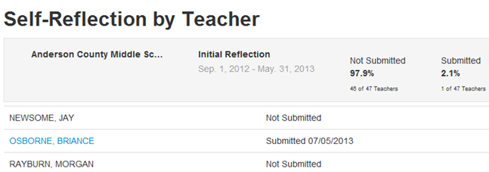
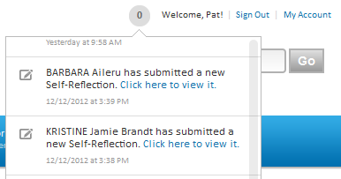
Principal Reviews Self-Reflection
Principals see:
Notifications
List of all teachers with access to completed forms
Date of submission
Percent not submitted
Notes:
To demo, sign out as a teacher and log back in as an administrator
Alert on home screen informs the administrator that a teacher has submitted self reflections
As an administrator click on Self-Reflection by Teacher to view teacher reflections
A blue link displays when a teacher has submitted their final self reflection - click the link to view
Not editable
In most cases this is viewed before an administrator would visit the submitted goals

Slide 7
PROFESSIONAL GROWTH PLANS
Notes:
If the audience is using the PD Planner, find out if they are currently using PD Plans or PD Goals so you can discuss the differences. These can be turned off to avoid confusion.

Slide 8
Professional Growth Plan Workflow
Principal selects an area of focus for the school, such as Instruction
Teachers select additional personal goals, such as Effective Classroom Management
Principal approves the teacher’s goals
Teachers perform a self-assessment for both personal and school goals
Throughout the year, teachers monitor their own progress based on classroom observation scores and student perception survey results
Notes:
- Survey results may not be available

Slide 9
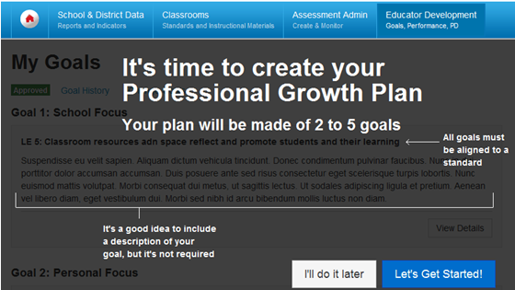
Teacher Prompt to Choose Goals
Notes:
EDS home page has a link alerting teachers if they have not set goals
Link goes to this screen
The Intro screen will clearly indicate to them the minimum and maximum number of goals they can choose as part of their PGP
These values come from the PGP settings defined by the system operator
The Intro screen also explains the other aspects of goal creation
Teachers can start their PGP creation right away or come back at a later time by choosing the ‘I’ll do it later’ option
These plans will be aligned to Professional Standards and submitted for approval
Approval is performed at the administration level

Slide 10
Choose Goals
Notes:
Choosing Goals
Once they opt to start the PGP creation, teachers are taken to Step 1 of their goal creation process
Here they are prompted to pick their first goal based on the recommendation of the principal
Let participants know if their configuration is set for teachers to select their focus at either the expectation or indicator level (level two or level three, respectively)
The teacher will be prompted to pick all the mandatory goals
Teachers have the option to align multiple goals to the same standard

Slide 11
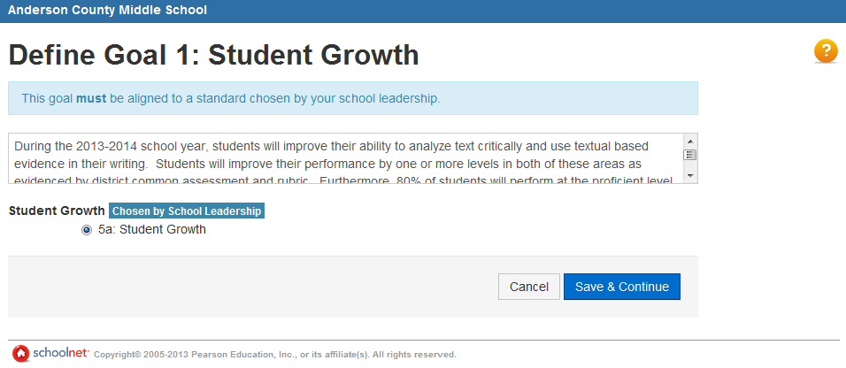
Optional Goal Description
Notes:
``During the 2013-2014 school year, students will improve their ability to analyze text critically and use textual based evidence in their writing. Students will improve their performance by one or more levels in both of these areas as evidenced by district common assessment and rubric. Furthermore, 80% of students will perform at the proficient level overall on the post-assessment.``
Save and Continue to the next goal. Teachers must input a minimum of 2 goals and a max of 5
Save and continue to additional goals

Slide 12
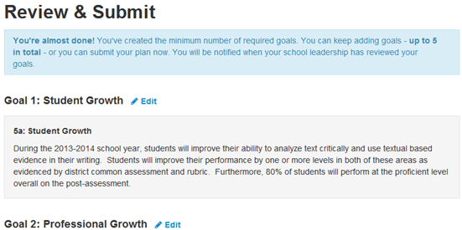
Review and Submit Goal
Notes:
Review & Submit
Once they are done selecting all the mandatory goals, they will be taken to the Review & Submit view, which will give them the ability to add additional goals if they choose to do so
Once they have created all their goals, they will be able to Review them before submitting them for approval
Now that you have entered your Professional Goals, submit your goals for approval. Once submitted an administrator will change the status of your personal goals to Approved if they are accepted or rejected. Rejected PGPs are rolled back to the last previously approved PGP and retain their status of accepted. Administrators can set the status to Revision Requested if they would like to discuss your selection. You will receive an email and notification once your PGP is approved, rejected, or a conversation is requested.
While pending approval user may edit their goals, however they will not be able to revert back to original goals

Slide 13
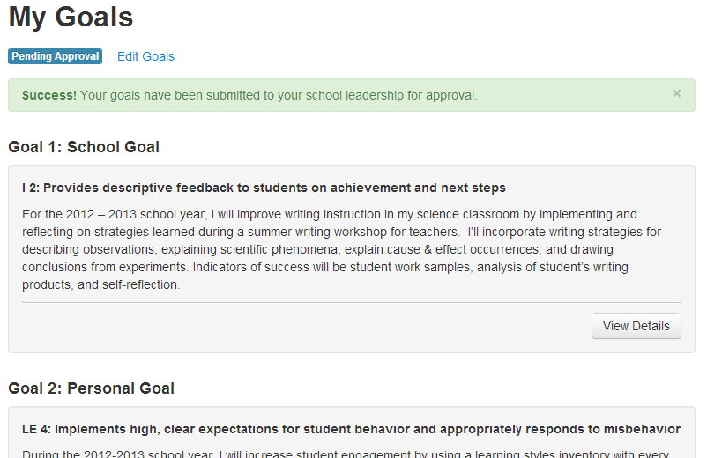
Pending Goals
Notes:
While Pending approval user may edit their goals. However they will not be able to revert back to original goals
Once the PGP is approved, the teacher’s new goals will be used across the EDS as evidence of the work they are focusing on. It will be available in the PGP Home page, EDS dashboard, and in any future observations that are performed for the teacher.
Teachers will be able to get to their detailed goals by choosing to “View Details”
If teachers wish to change their PGP after approval, they are clearly informed that this will result in the creation of a new PGP

Slide 14
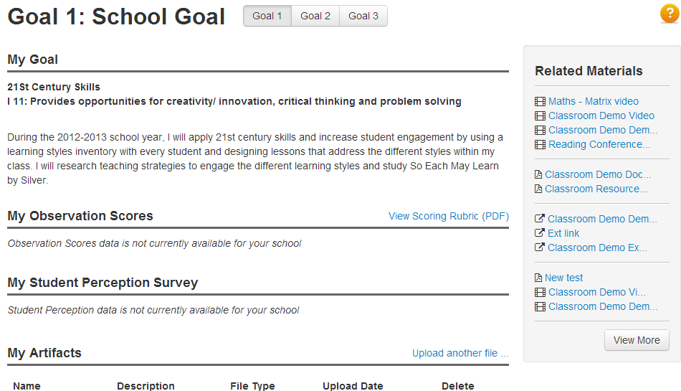
Attach Supporting Evidence

Slide 15
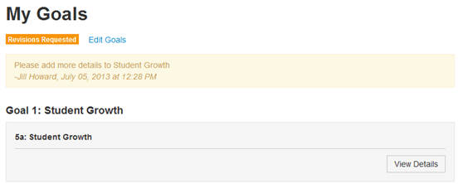
Revise and Submit if Needed
Notes:
What the teacher will see when PGP have been sent back for revisions. Teachers can now click Edit Goals and resubmit.

Slide 16
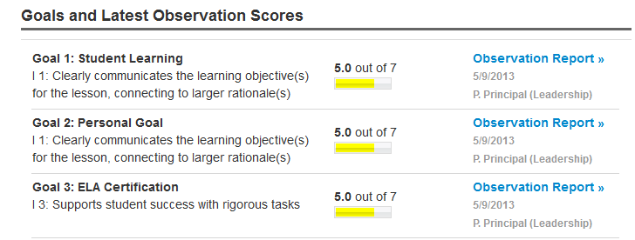
Goal Indicators
Teacher goals are reflected throughout the site
Notes:
The Goal indicators are updated in various parts of the application and out-bound communication to the user such as emails and notifications. Some examples are : My Observation Report and PGP web part
•

Slide 17
About Classroom Observations
Observations can be performed by leadership or peers
Type can be Full, Partial, or Walkthrough
Make sure there is consensus on what these observations mean and which ones to perform.
Observations can be scheduled or unscheduled
Your site is configured to allow either one or multiple observations per window
Notes:
Communicate:
Whether one or multiple observations is allowed per window
If observations will be by leadership, peers or both

Slide 18
VIEW OBSERVATION DATA

Slide 19
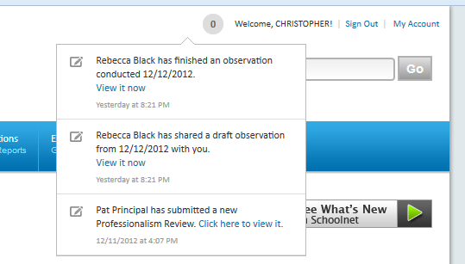
Observation Notifications
Alerts provided to teachers when observers have shared draft or final observations

Slide 20
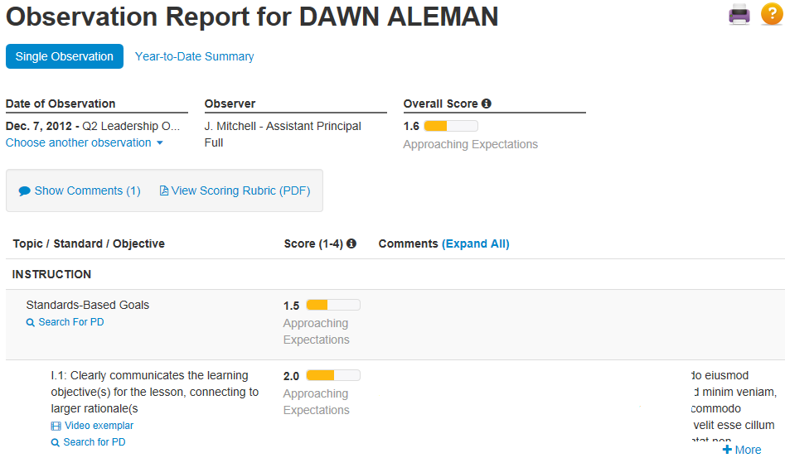
Teacher Views Observation Results
Enter a comment
Search for supporting resources in PD Planner
Video exemplars
Notes:
- May see video exemplars that demonstrate application of a PD standard
Overall score may be configured on or off, as applicable
Year-to-date option

Slide 21
STUDENT PERCEPTION SURVEYS

Slide 22
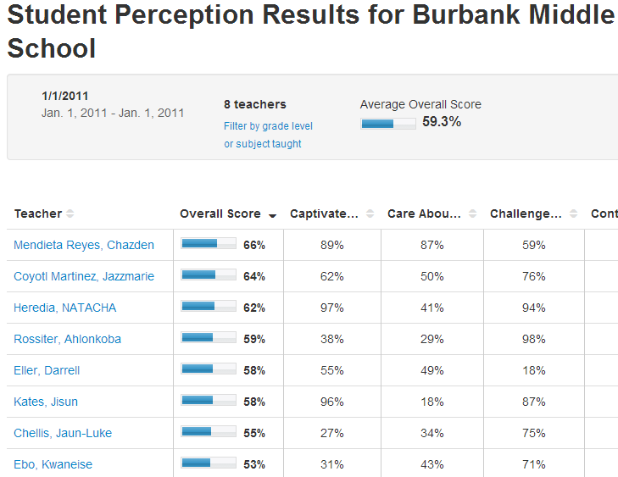
Student Perception Results
Student perception standards are mapped to professional development standards, providing a thread that allows teachers to find related professional development
Notes:
- Student Surveys take place outside of Schoolnet and are loaded for teachers and leadership to view in a report
- Perception results are summarized before being loaded. Averages per teacher are loaded per student perception “standard” area.

Slide 23
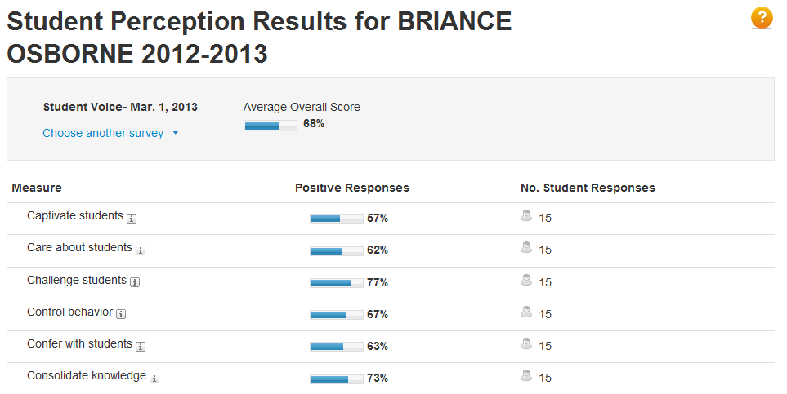
Student Perception Results
Notes:
Pricipals have the ability to drill down into each teacher student perception results

