Slide 1
What is the Educator Development Suite?
Provides teachers with the results of classroom observations and student perception surveys
Suggests contextualized professional development tools to interested teachers
Reports observation scores by school or by teacher to school and district administrators
Allows teachers and schools to set and track goals for improvement
Notes:
Districts need to generate high-fidelity measures of educator quality and performance with both accuracy and fairness. Schoolnet provides a flexible, multiple-faceted approach to the creation of the educator effectiveness ratings, enabling districts to design their own model for measuring educator effectiveness and analyzing data using a series of interactive reports and dashboards.

Slide 2
Teacher Effectiveness
Continuum of Evidence
Professional Learning Communities
Self Assessment
Survey
Data
Walk-through Observations
District
Tests
State
Tests
(Value-Add)
PD Results
Certification
Leading
Formative
Diagnostic
Assessment for Learning
Lagging
Summative
Accountability
Assessment of Learning
Notes:
Originally, Schoolnet was only able to load information such as teacher certifications and credit for professional development activities. Recently, with the new EDS Suite, the focus is on moving toward functionality that supports Assessment for Learning, such as surveys and walk-throughs.

Slide 3
Framework
Observations are aligned to the framework selected by your district
The framework can be aligned to professional development offerings in PD Planner so that teachers can act upon their observation results
Notes:
Briefly discuss what framework is being used (for instance Marzano or Danielson). Compare to student standards.

Slide 4
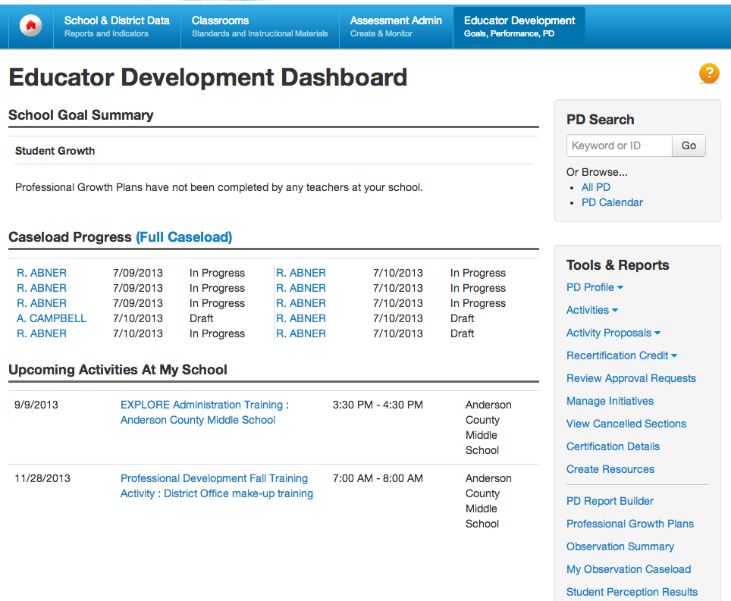
Navigating in EDS
Notes:
Have participants sign in to their site (or a training site if available) and view the EDS home page
Show the difference between rolling over a header and clicking it
The EDS home page includes PD Planner links and is tailored to your role
Point out that system operator can tailor external links and messages
May have a webpart on My Schoolnet home page

Slide 5
Self-reflection
Notes:
Skip this section if not applicable.

Slide 6
Teacher Completes Self-Reflection
Can save in-progress work before submitting
Scoring help may be available
Notes:
Hover over Educator Development and click Self-Reflection under Tools & Reports. If more than one exists, use the drop-down next to Self-Reflection to toggle between them. The labels on this toggle correspond to windows when self-reflections can take place and are not created or configurable by teachers.
Select from drop down and enter notes for each skill. Each skill must be commented on.
Optional: Click Save at the bottom or top of the form to save your changes, but not share it with any other users.
Click Submit Final to submit your self-reflection. You are not able to edit your self-reflection once it has been submitted, and both you and your school leadership will be able to view it.

Slide 7
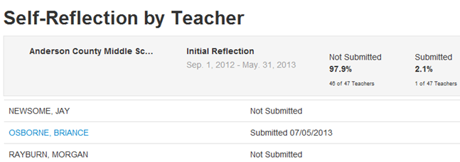
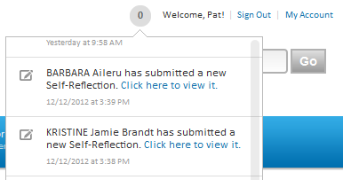
Principal Reviews Self-Reflection
Principals see:
Notifications
List of all teachers with access to completed forms
Date of submission
Percent not submitted
Notes:
To demo, sign out as a teacher and log back in as an administrator
Alert on home screen informs the administrator that a teacher has submitted self reflections
As an administrator click on Self-Reflection by Teacher to view teacher reflections
A blue link displays when a teacher has submitted their final self reflection - click the link to view
Not editable
In most cases this is viewed before an administrator would visit the submitted goals

Slide 8
PROFESSIONAL GROWTH PLANS
Notes:
If the audience is using the PD Planner, find out if they are currently using PD Plans or PD Goals so you can discuss the differences. These can be turned off to avoid confusion.

Slide 9
Professional Growth Plan Workflow
Principal selects an area of focus for the school, such as Instruction
Teachers select additional personal goals, such as Effective Classroom Management
Principal approves the teacher’s goals
Teachers perform a self-assessment for both personal and school goals
Throughout the year, teachers monitor their own progress based on classroom observation scores and student perception survey results
Notes:
- Survey results may not be available

Slide 10
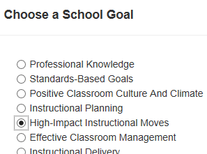
Principal Sets School Goal
Notes:
Before we ask teachers to pick their goals, the principal needs to pick the school goal, which may vary from this example. (Show with the slide if you don’t have a principal account that has not picked a goal.)
On their EDS home page, they will see a note to choose the school goal. These are the top level framework categories. Once they pick, teachers can do their part. Principal needs to communicate to teachers to do this step.
Note: Depending on timing of training and audience, principals may have already performed this step.

Slide 11
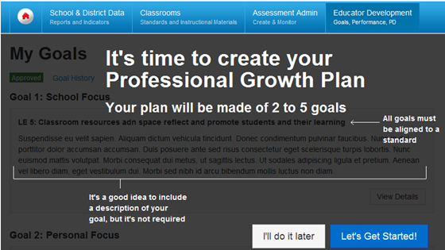
Teacher Prompt to Choose Goals
Notes:
EDS home page has a link alerting teachers if they have not set goals
Link goes to this screen
The Intro screen will clearly indicate to them the minimum and maximum number of goals they can choose as part of their PGP
These values come from the PGP settings defined by the system operator
The Intro screen also explains the other aspects of goal creation
Teachers can start their PGP creation right away or come back at a later time by choosing the ‘I’ll do it later’ option
These plans will be aligned to Professional Standards and submitted for approval
Approval is performed at the administration level

Slide 12
Choose Goals
Notes:
Choosing Goals
Once they opt to start the PGP creation, teachers are taken to Step 1 of their goal creation process
Here they are prompted to pick their first goal based on the recommendation of the principal
Let participants know if their configuration is set for teachers to select their focus at either the expectation or indicator level (level two or level three, respectively)
The teacher will be prompted to pick all the mandatory goals
Teachers have the option to align multiple goals to the same standard

Slide 13
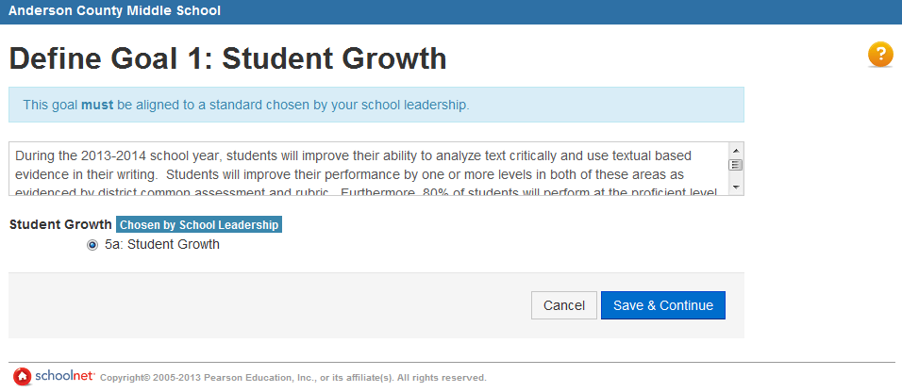
Optional Goal Description
Notes:
``During the 2013-2014 school year, students will improve their ability to analyze text critically and use textual based evidence in their writing. Students will improve their performance by one or more levels in both of these areas as evidenced by district common assessment and rubric. Furthermore, 80% of students will perform at the proficient level overall on the post-assessment.``
Save and Continue to the next goal. Teachers must input a minimum of 2 goals and a max of 5
Save and continue to additional goals

Slide 14
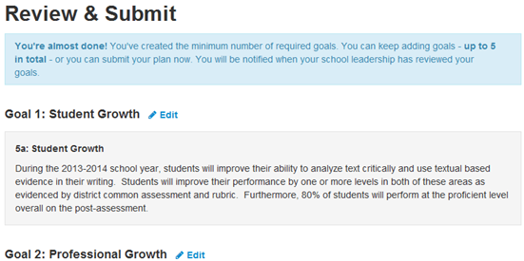
Review and Submit Goal
Notes:
Review & Submit
Once they are done selecting all the mandatory goals, they will be taken to the Review & Submit view, which will give them the ability to add additional goals if they choose to do so
Once they have created all their goals, they will be able to Review them before submitting them for approval
Now that you have entered your Professional Goals, submit your goals for approval. Once submitted an administrator will change the status of your personal goals to Approved if they are accepted or rejected. Rejected PGPs are rolled back to the last previously approved PGP and retain their status of accepted. Administrators can set the status to Revision Requested if they would like to discuss your selection. You will receive an email and notification once your PGP is approved, rejected, or a conversation is requested.
While pending approval user may edit their goals, however they will not be able to revert back to original goals

Slide 15
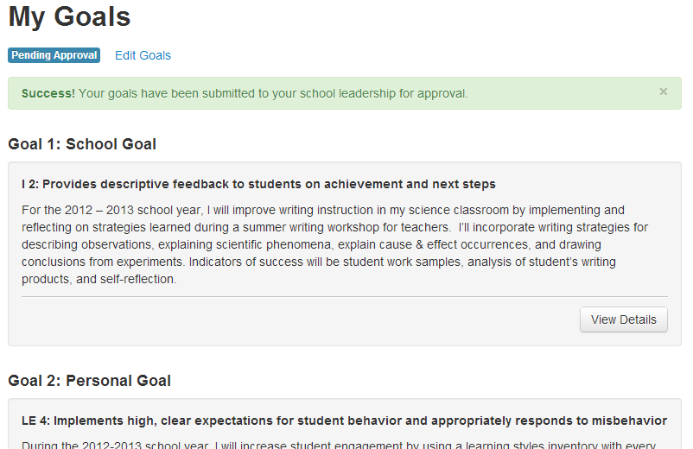
Pending Goals
Notes:
While Pending approval user may edit their goals. However they will not be able to revert back to original goals
Once the PGP is approved, the teacher’s new goals will be used across the EDS as evidence of the work they are focusing on. It will be available in the PGP Home page, EDS dashboard, and in any future observations that are performed for the teacher.
Teachers will be able to get to their detailed goals by choosing to “View Details”
If teachers wish to change their PGP after approval, they are clearly informed that this will result in the creation of a new PGP

Slide 16
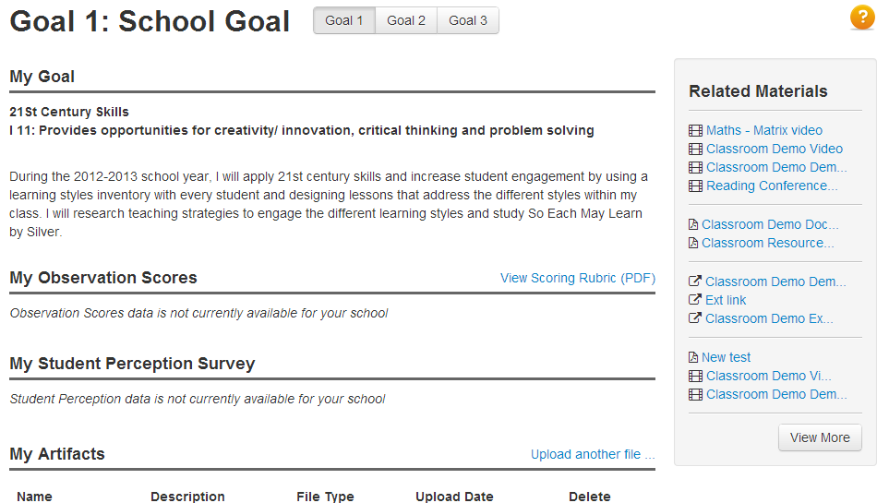
Attach Supporting Evidence

Slide 17
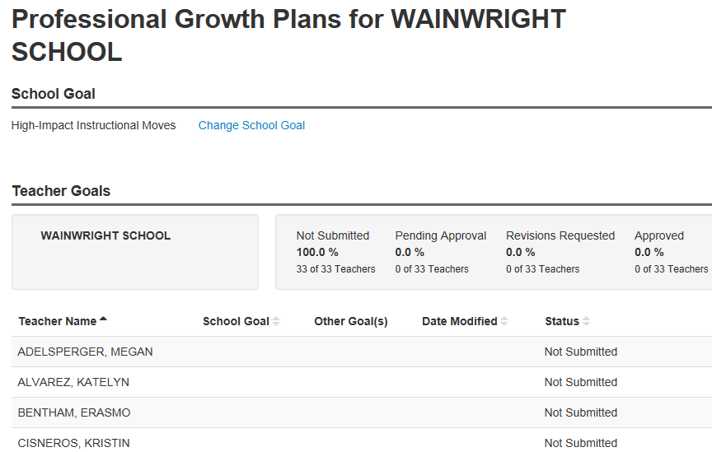
Principal Tracks Submit Status
Notes:
As an Administrator click on Professional Growth Plans to view and Approve teachers goals for the year
The principal can view a summary showing the teachers who still need to submit
Use the same screen to approve goals
Teachers who have submitted PGPlans will display in blue hyperlink. Click the link to view the PGP
School and district leadership can access a teacher’s past PGP by clicking through from their view.
Principals also have a way of seeing all the PGP goals in case they have multiple goals
Notification that an administrator has sent back a Teachers PGP for revisions
When approve is selected the teacher will receive a notification that their goals have been approved

Slide 18
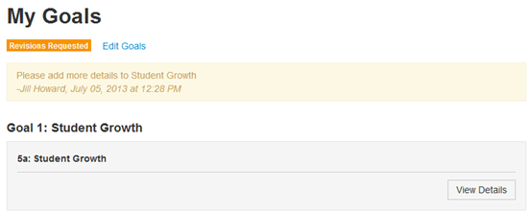
Revise and Submit if Needed
Notes:
What the teacher will see when PGP have been sent back for revisions. Teachers can now click Edit Goals and resubmit.

Slide 19
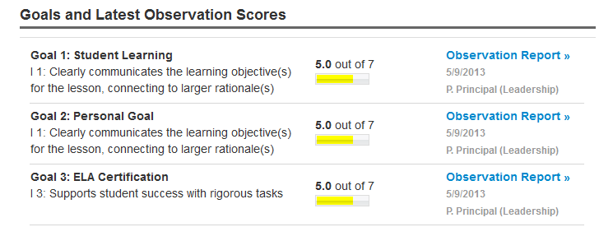
Goal Indicators
Teacher goals are reflected throughout the site
Notes:
The Goal indicators are updated in various parts of the application and out-bound communication to the user such as emails and notifications. Some examples are : My Observation Report and PGP web part
•

Slide 20
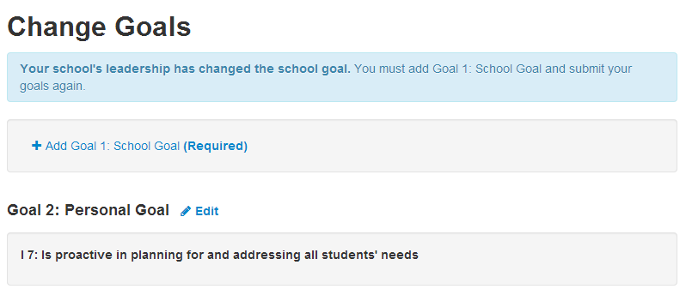
Change School Goals
Principals, along with district leadership, can change school goals during the year
Notes:
Any changes to the School Goal will take require teachers to get in and select a new goal
Teachers will receive an email explaining the changes made by the school leadership
On clicking the link provided, all teachers will be redirected to their PGP Summary page
Teachers will be provided some friendly messaging on next steps and they can then take necessary actions

Slide 21
PLANNING FOR CLASSROOM OBSERVATIONS

Slide 22
About Classroom Observations
Observations can be performed by leadership or peers
Type can be Full, Partial, or Walkthrough
Make sure there is consensus on what these observations mean and which ones to perform.
Observations can be scheduled or unscheduled
Your site is configured to allow either one or multiple observations per window
Notes:
Communicate:
Whether one or multiple observations is allowed per window
If observations will be by leadership, peers or both

Slide 23
Pre-Tasks for System Operator
Score group template* - Determine the scoring rubrics that will be used for observations.
Add rubrics
Observation template* - Determine which standards will and will not be observed, identify the score group template and the scoring help rubric that you will use
Define observation windows* - Will there be observation windows for each observer type? How many?
* Warning: Cannot be edited or deleted once in use!
Notes:
Hide this slide if tasks completed.
Although the scope of this training does not include covering configuration tasks, it may be useful to understand the work that needs to be in place before you can conduct observations. When planning for the first observation window, keep in mind that all these steps need to happen first.

Slide 24
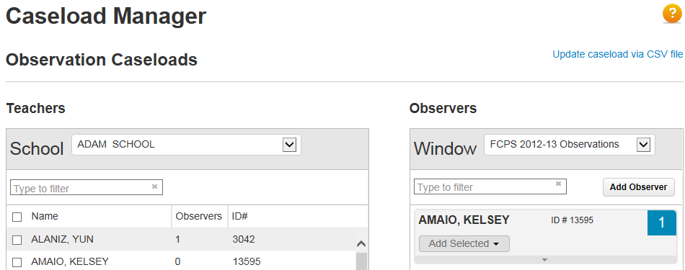
Manage Caseload
Users with the “Observe all teachers at an institution” operation can perform observations for all teachers in the school automatically
Match peer observers with observees in Caseload Manager
Notes:
Prior to observations, determine who will observe and be observed. Can also upload via csv file

Slide 25
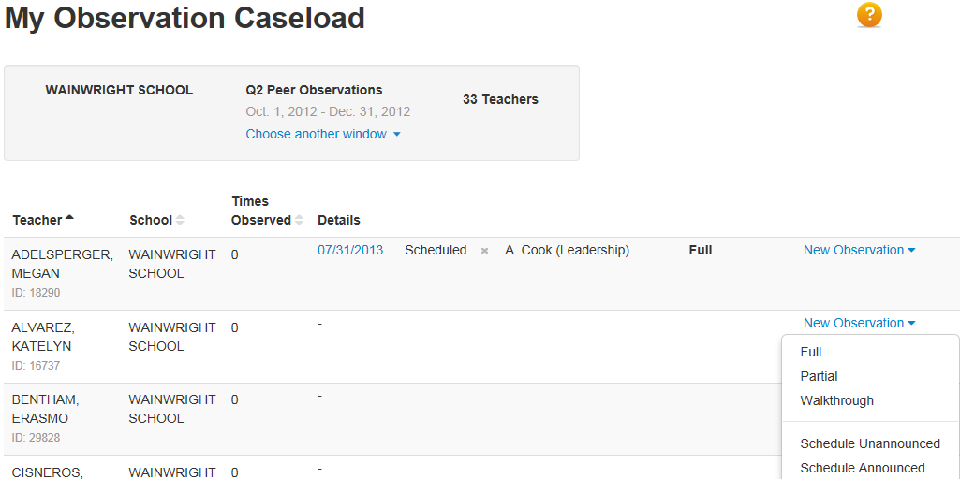
View Caseload
Notes:
To access a list of observees, click My Observation Caseload from EDS sub-menu
Make sure you are in the correct observation window
On this screen administrators can select the window of observation
Create a new observation of a teacher.
When the correct window has been selected use the drop down on New observation to select the type of observation that will be conducted.
Full – Full classroom Period
Partial – Observation (mini) – 20-30 mins of a class
Walkthrough (not used in KY)
Schedule Unannounced - will allow an administrator to schedule observations in the future (teachers will not be notified)
Schedule Announced - will allow an administrator to schedule observations in the future (teachers will be notified)

Slide 26
Schedule an Observation
Observers can schedule an observation for the future and record the following information:
Date
Time
Observation type
Location
Unannounced observations
Sends an email notification and calendar invite to the observer only
Announced observations
Sends an email notification and calendar invite to both the observers and the teacher
Notes:
Changing scheduled observation’s details and clicking Set/Send Appointment sends updated email notification/calendar invite
Cancelling a scheduled observation sends an email notification/calendar invite cancellation.
Clicking Observe Now launches an observation. The scheduled item on caseload is replaced with an observation record.
Once observation has been scheduled, it appears on the caseload as “Scheduled.”

Slide 27
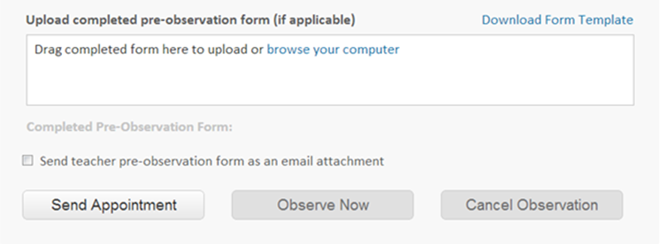
Pre-observation Template
Observer can choose to have a pre-observation form template included as an attachment in the scheduling email/calendar invite that is sent to the teacher
Notes:
If observations aren’t scheduled by observer and a pre-observation form is required, discuss how teacher will obtain the form.
Location of completed pre-observation forms:
Scheduling view
Observation form
Final observation report

Slide 28
Starting the Observation
Indicate the observation date, the type, and the section being observed
If a post-observation conference is planned, indicate the date
Make note of the goals selected by the teacher
Notes:
Conference date is informational only. It does not trigger an email. This will appear as read-only for teachers, and the final observation report will have a record of when the post-observation conference occurred.

Slide 29
Conduct Observation
Depending on the observation type, score tiles may be included
If available, use scoring rubrics for help
Capture notes that will not be shared with teachers in the scripting area
Scripting are text can be copied to comment areas
Notes:
If they have configured scoring, you must select a score for every measure. You can intentionally not score on a measure by selecting N/A. This is for cases where you would like to leave comments without scores or skip scoring on a measure altogether.
- May see icons that relate PD standards to multi-dimensional teaching themes

Slide 30
Save and Submit Observation
Autosave | Saves automatically every 60 seconds, and a "Last saved" confirmation message appears.
Save | Saves the form as In Progress at any time.
Share draft with teacher | Saves and shares it with the teacher being observed. An email notification is sent to the teacher, and a confirmation is sent to yourself.
Share updated draft | Saves and share updated version with the teacher being observed. An email notification is sent to the teacher, and a confirmation is sent to yourself.
Submit final | Submits your final observation to the teacher, as well as their principals and administrators. Note that after this button is clicked, you will not be able to make any further changes to your observation.

Slide 31
Deleting Observations
Observers can delete their own In Progress observations
System Operators (or other users) with the Delete Observations operation can delete other users’ In Progress or Draft observations

Slide 32
VIEW OBSERVATION DATA

Slide 33
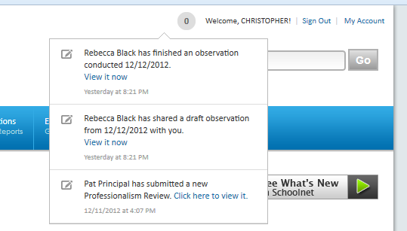
Observation Notifications
Alerts provided to teachers when observers have shared draft or final observations

Slide 34
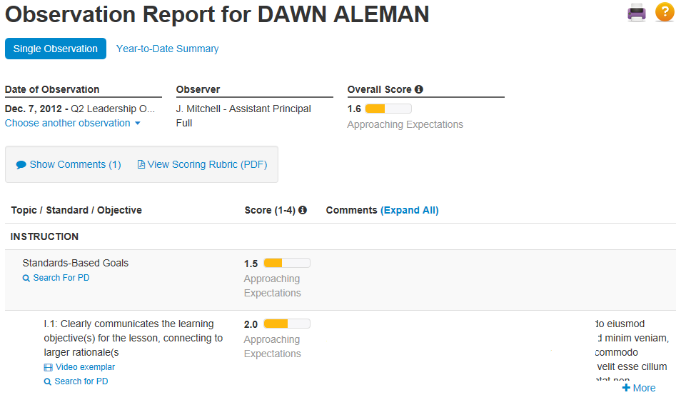
Teacher Views Observation Results
Enter a comment
Search for supporting resources in PD Planner
Video exemplars
Notes:
- May see video exemplars that demonstrate application of a PD standard
Overall score may be configured on or off, as applicable
Year-to-date option

Slide 35
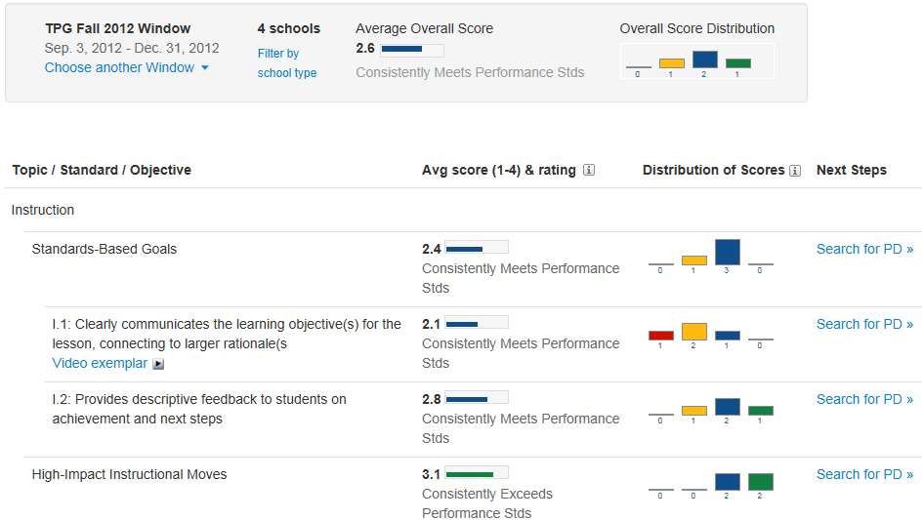
Principal Views Observation Results
Notes:
View distribution of scores by standard

Slide 36
Observation Reports
Report | Teacher | Observer | Leadership
Single Observation Report | x | x | x
Year-to-Date Summary | x | x | x
Observation Summary Reports per Standard |  |  | x
Observation Summary Report per Teacher |  |  | x
Observation Summary Report per School |  |  | District level only
Observation Progress per District |  |  | State sites only
Notes:
View the available reports – note that ‘by standard’ and ‘by teacher’ are actually views within a report
Single Observation Report: Available to teachers and observers, these reports provide an overview of a single observation that has occurred, including comments and final, submitted scores. Observers can attach files for these submitted reports that may be evidence towards the teacher's practice (for example, lesson plans).
Year-to-Date Summary Report: Trend of observation scores that have occurred in the past year. A toggle is available to this report from Single Observation Reports for teachers. Leadership and district administrators also have year-to-date trend lines in their by Teachers reports.
Observation Summary Reports per Standard: Available to leadership and district administrators, these reports average the observation data for all teachers in a school, or all schools in a district/region based on the standards they were scored on.
Observation Summary Report per Teacher: Available to leadership and district administrators, these reports show the scores per sub skill for each teacher based on their latest observations. If a few observations have been recorded for any teacher and sub skill, a year-to-date trend line is visible.
Observation Summary Report per School: Available to district administrators, these reports average observation scores for a sub skill for each school in a district.
Observation Progress per District: For multi-tenant sites.

Slide 37
STUDENT PERCEPTION SURVEYS

Slide 38
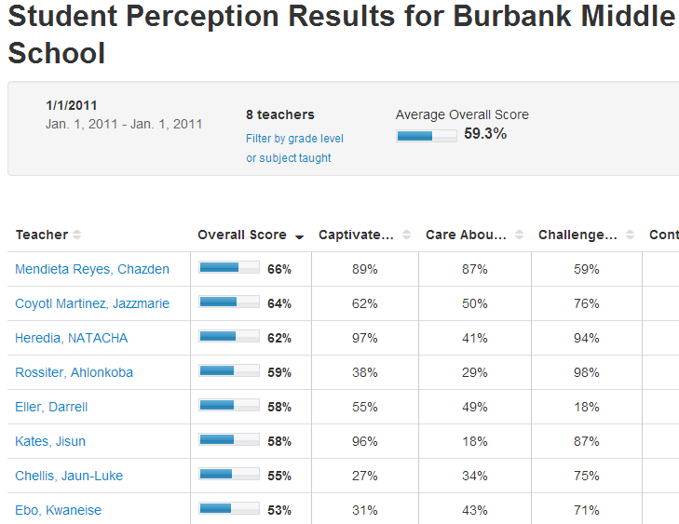
Student Perception Results
Student perception standards are mapped to professional development standards, providing a thread that allows teachers to find related professional development
Notes:
- Student Surveys take place outside of Schoolnet and are loaded for teachers and leadership to view in a report
- Perception results are summarized before being loaded. Averages per teacher are loaded per student perception “standard” area.

Slide 39
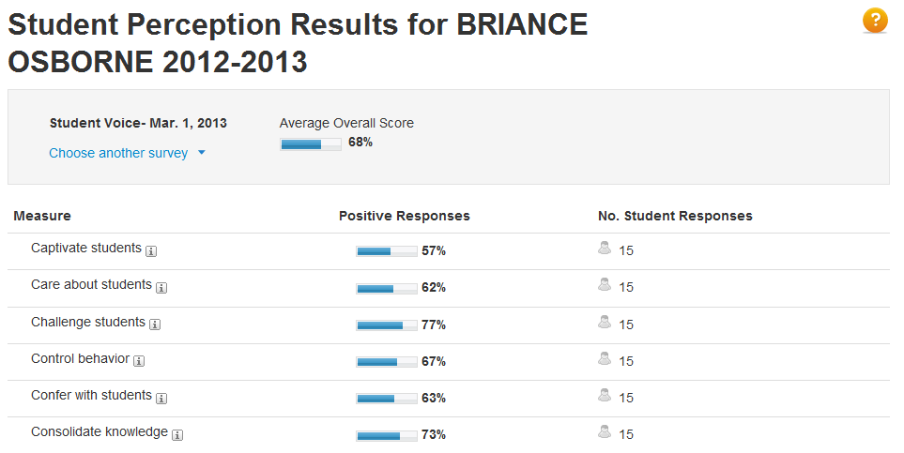
Student Perception Results
Notes:
Pricipals have the ability to drill down into each teacher student perception results

