Slide 1
What is Classrooms?
Classrooms is a module of Schoolnet that:
Provides teachers with standards-based instructional tools, lessons and best practices
Delivers class and student level data to the teacher’s desktop
Provides teachers the information they need anytime and anywhere 24/7
Notes:
Highlight the focus of today – reporting on classroom assessments
Because it is web based, you can use Classrooms anywhere you have internet access.

Slide 2
HOW DO I CREATE INSTRUCTIONAL MATERIALS?

Slide 3
Instructional Materials
In Classrooms, “Instructional Material” refers to:
Curriculum
Curricular Units
Instructional Units
Lessons
Resources
Assessments
Note
Teachers are permissioned to create:
Instructional Units
Lessons
Resources
Assessments
Notes:
Before we start, useful to understand..
Curricular Units are collections of instructional units. These can only be created by users with the Curriculum Manager role in CMD – a desktop tool for creating curriculum. CUs are the largest pieces (building blocks) that make up curriculum
Instructional units (use district specific term if applicable) are more granular chunks of CUs.
Lessons we all know. The lesson may be done fully in the Classrooms template or perhaps be an attachment to a file or a link to where the lesson actually lives.
Assessments should not be confused with standardized test and benchmarks (if applicable) found elsewhere in Schoolnet. Results from these tests can’t be loaded as data. However, they can include unit tests, quizzes, grading rubrics, etc.
Resources are a catch all for everything else. They can be attached to units or lessons or stand independently. Might include URLs, video titles (but not actual video clips), graphics such as maps, etc.

Slide 4
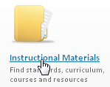
Create Materials
Notes:
Search by subject, grade, keyword, standard, material type, and more
Demonstrate how to search and save to My Materials
Just click Search to see all available filters or browse available materials
Note: Initially, no materials may have been made available
External bank may be available

Slide 5
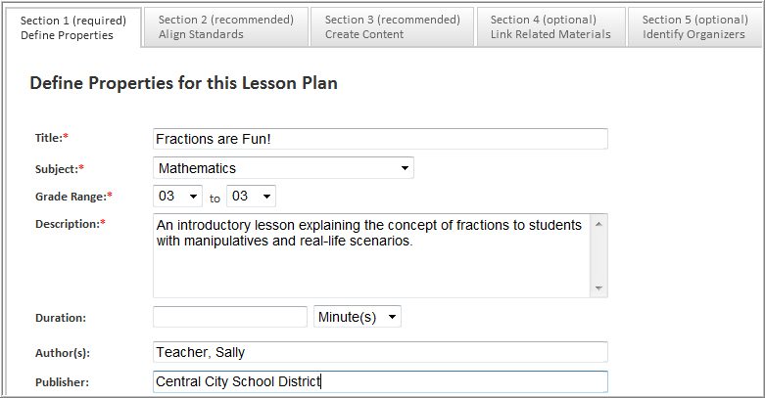
Create a Lesson
Notes:
In the lesson template, enter the information identified by the “*” required fields. If your lesson already exists in another document, you can simply copy and paste the fields into this template.

Slide 6
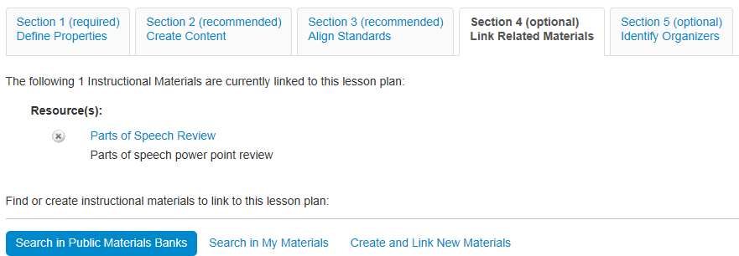
Attach Resources to a Lesson
Attach support materials to lessons
Use the same resource for multiple lessons
Notes:
Instructional units – Attach lesson plans, resources, and assessments
Lesson plans – Attach resources and assessments
This is the only way to add an attachment when using the district template
Can pull from bank, My Materials, or create on the fly; new resources become separate material
Show organizers in next tab
Show how to view detail to exit and return to lesson through My Materials

Slide 7
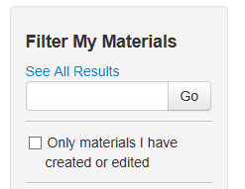
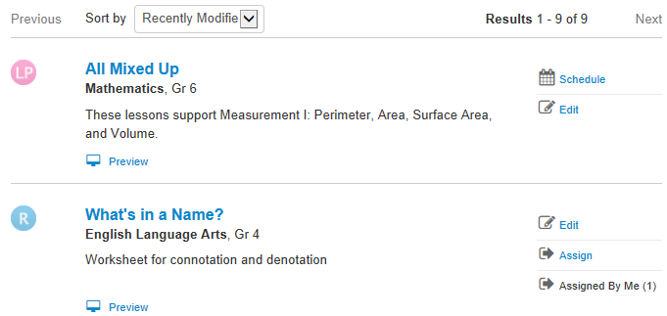
My Materials
A combination of the materials that you created and those you saved from a materials search
Notes:
This stays from one school year to the next
Filtering works the same way as in the Materials Bank

Slide 8
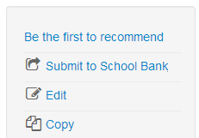
Submit a Lesson Plan for Approval Share with Other Teachers
Materials you create can be shared with other teachers by submitting for approval
You cannot edit the lesson plan once it is approved, however you can create and edit copies.

Slide 9
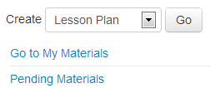
Approval Process
Designated administrators can approve materials or request revisions. Approved materials are available to other teachers.

