Slide 1
What is Classrooms?
Classrooms is a module of Schoolnet that:
Provides teachers with standards-based instructional tools, lessons and best practices
Delivers class and student level data to the teacher’s desktop
Provides teachers the information they need anytime and anywhere 24/7
Notes:
Highlight the focus of today – reporting on classroom assessments
Because it is web based, you can use Classrooms anywhere you have internet access.

Slide 2
HOW DO I LOCATE, INSTRUCTIONAL MATERIALS?

Slide 3
Instructional Materials
In Classrooms, ‘Instructional Materials’ refers to:
Curriculum
Curricular Units
Instructional Units
Lesson
Resources
Assessments
Notes:
Before we start, useful to understand..
Curricular Units are collections of instructional units. These can only be created by users with the Curriculum Manager role in CMD – a desktop tool for creating curriculum. CUs are the largest pieces (building blocks) that make up curriculum
Instructional units (use district specific term if applicable) are more granular chunks of CUs.
Lessons we all know. The lesson may be done fully in the Classrooms template or perhaps be an attachment to a file or a link to where the lesson actually lives.
Assessments should not be confused with standardized test and benchmarks (if applicable) found elsewhere in Schoolnet. Results from these tests can’t be loaded as data. However, they can include unit tests, quizzes, grading rubrics, etc.
Resources are a catch all for everything else. They can be attached to units or lessons or stand independently. Might include URLs, video titles (but not actual video clips), graphics such as maps, etc.

Slide 4
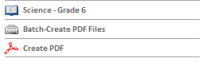
Locating Materials
In Classrooms
Materials Search
Throughout Classrooms
On Classrooms Home Page (for selected section only, once district maps curriculum to courses)
Notes:
By “curriculum”, we mean whatever scope and sequence, standards, units, etc., your district has organized and loaded for use with a particular course.
Not all courses have curricula assigned to them.
If a course or section does not have a curriculum mapped, the curriculum link will not appear in Classrooms home page or My Schoolnet

Slide 5
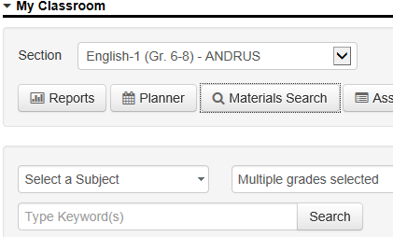
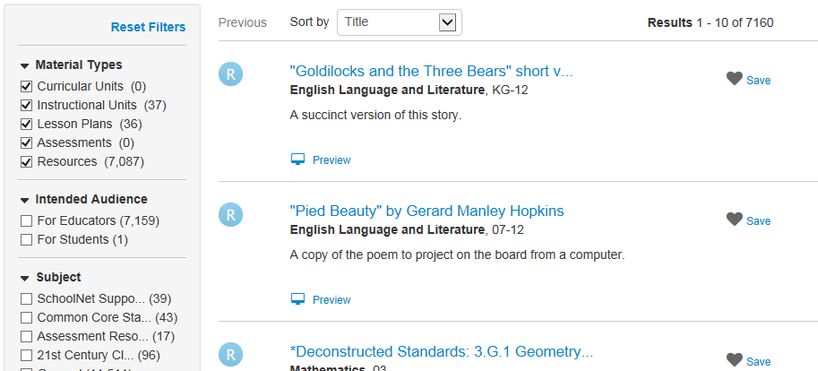
Search for Any Materials
Click Materials Search from
My Schoolnet
Filter by grade and subject
Notes:
Use this method to access curriculum for courses you do not teach (or that aren’t mapped to your course)

Slide 6
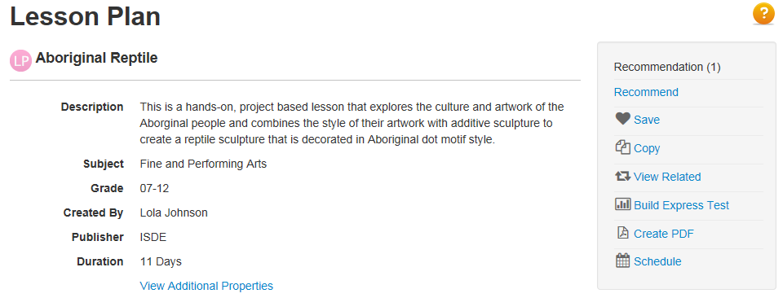
Materials Detail Page
View aligned standards and other materials tied to the same standards
Create PDF
Recommend
Save in My Materials for later
Build an Express Test (jump to Assessment Admin module, create test from standards aligned to selected material)
Schedule in your lesson planner (teachers only)
Notes:
Click materials title to access detail page

Slide 7
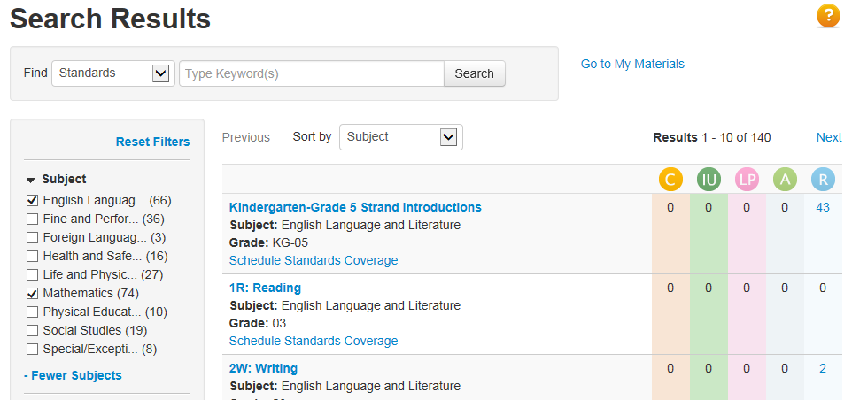
Standards Search
Search for standards that contain a keyword
Locate all materials aligned to a standard
Schedule standards on the lesson planner
Be sure to search the appropriate level of the standards hierarchy
Notes:
Not only can you search for materials, but you can also search for standards and see what materials are available for each standard
Be sure to point out that you can only search for one level of the standards hierarchy at a time. Select which level in the bottom left
Use this screen to discuss the different material types—point to icons and then draw out the hierarchy on a whiteboard

Slide 8
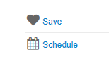
Navigating to My Materials
Add items to my materials from the overview or detail view

Slide 9
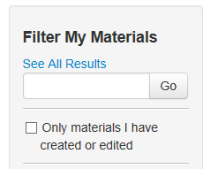
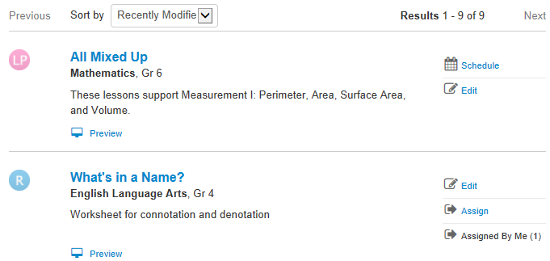
My Materials
A combination of the materials that you created and those you saved from a materials search
Notes:
This stays from one school year to the next
Filtering works the same way as in the Materials Bank

Slide 10
HOW CAN I PLAN INSTRUCTION IN ISEE?

Slide 11
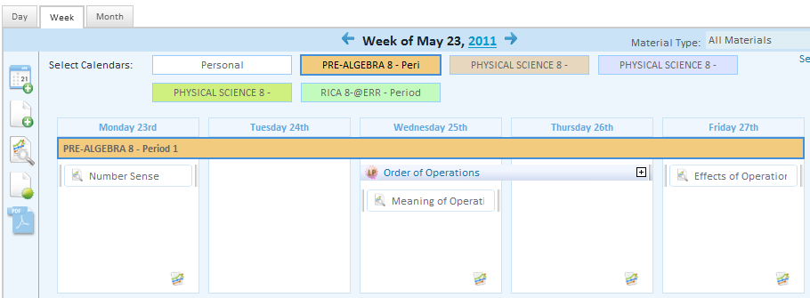
Lesson Planner
Teachers can schedule lessons, add notes, files, events, etc.
Personal and section views are available
Notes:
Your lesson planner can contain curriculum that has been scheduled to your section by the district (indicated with a yellow star) as well as items you schedule.

Slide 12
Navigating in Your Planner
Filter calendars by section or material type
Day, Week or Month view
Click drop-down arrow to open selector boxes – click arrow again to close them
Hover actions (such as over year to view past planners)
Drag and drop
Notes:
Navigating on your planner is easy - Click on box to filter by that section. You can also filter by material type.
When you click a drop-down arrow, for instance when filtering on just lessons, click the desired checkboxes and then click the blue arrow square to close the pop-up selector
To reduce visual clutter, some icons are hidden until you roll your cursor over them
‘Dragging and dropping’ is now supported

Slide 13
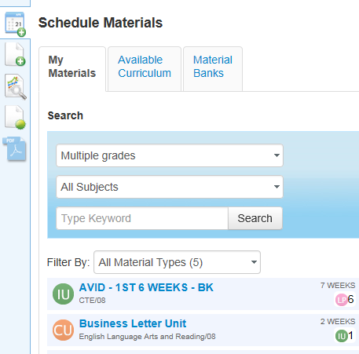
Schedule a Lesson or Unit
Choose materials from District-wide Materials Bank, School Bank, My Materials or Available Curriculum.
Must pick grade & subject
‘Hover’ to reveal four pointed arrow, then drag & drop.
Notes:
It is easy to schedule a lesson or instructional unit right from the planner. You can choose materials from the Materials Bank, School Bank or My Materials, filtering by grade and subject. Hovering your cursor over the material reveals a schedule icon – click and hold down while dragging it to the desired day and section.
The 'Materials Bank' contains all district approved/pushed materials, the 'School Bank' includes all school approved/pushed materials (at user's school or other schools within the district). Only those School Bank materials that have also been submitted for approval by the district will also appear in the Materials Bank. In some districts only school bank tab is available.
The Available Curriculum tab provides the ability for a teacher to access, view and self-schedule a set of instructional materials that are components of an assigned curriculum but have not been scheduled. This is helpful for districts that wish to provide broad pacing to teachers, but do not wish to prescribe a very structured and paced instructional program

Slide 14
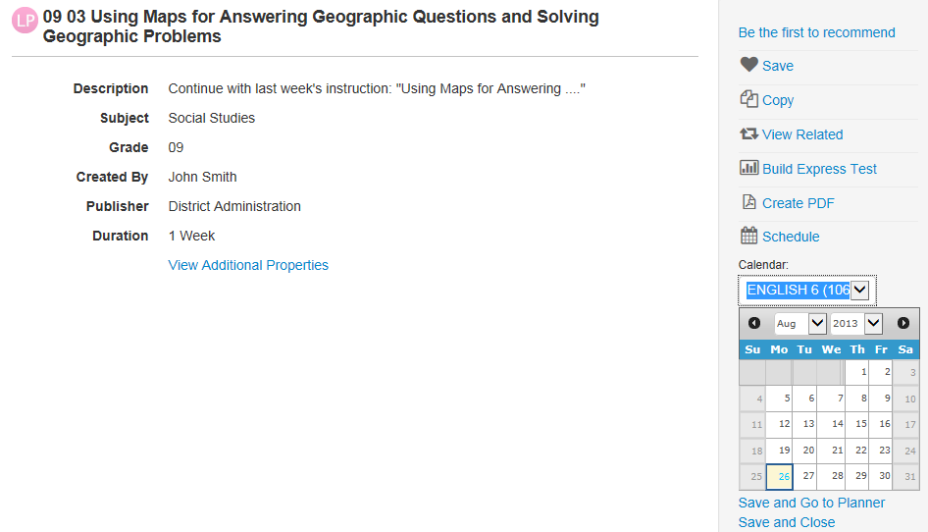
Schedule Material from within Detail Screen
Access detail screen by clicking title in Materials Search or My Materials
Click Schedule to view mini calendar
‘Save and Go to Planner’ or ‘Save and Close’
Notes:
From My Materials or Materials search, click on the material title to access the light box. From here you can schedule the lesson or unit on the planner

Slide 15
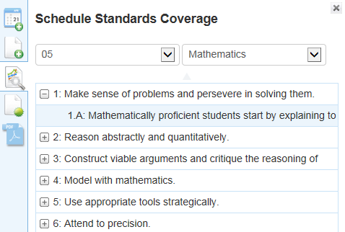
Add Standards Coverage
Use to keep track of standards covered without actually posting a lesson in Classrooms. Select standard and drag and drop to day square.
Notes:
If you have a lesson on paper (or in your head) that you plan on teaching and don’t want to spend the effort posting in Classrooms, you may still wish to keep track of the standards covered. In effect you are scheduling just the standards without the lesson content. You can schedule just a specific standard, or a standard plus any sub-standards underneath.

Slide 16
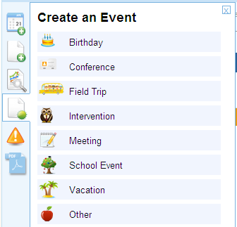
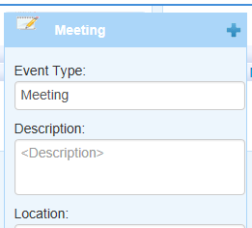
Add Events
Drag and drop desired event to day square.
Enter details.
Click to close detail window.
Notes:
A number of event types are available for dragging and dropping to your calendar. Additional details can be added as needed. You can add these to the personal and/or section calendars.

Slide 17
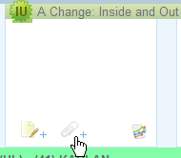
Attach Files to Any Day
Roll cursor over bottom of day square.
Click paperclip icon that appears.
Choose and attach file.
Paperclip visible to indicate available file.
Notes:
Upload attachments, up to 5 per section per day. This could be flyers for parents to print and hand out, instructional support materials, forms, etc.
Roll your cursor over the bottom of a ‘day square’ click the paperclip icon. Choose and attach the file. Now the paperclip indicates that a file is attached to that day.
Note that these attachments only appear here – anything you want to be available next year in My Materials should still be added as a lesson or resource.

Slide 18
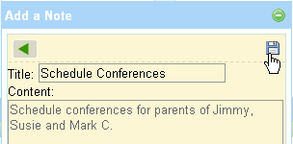
Add a Note to Any Day
Roll cursor over bottom of day square.
Click note icon that appears.
Enter title and content
Click Save ( )icon.
Note icon is visible to indicate added note.
Notes:
In much the same way you can add a note to any day

Slide 19
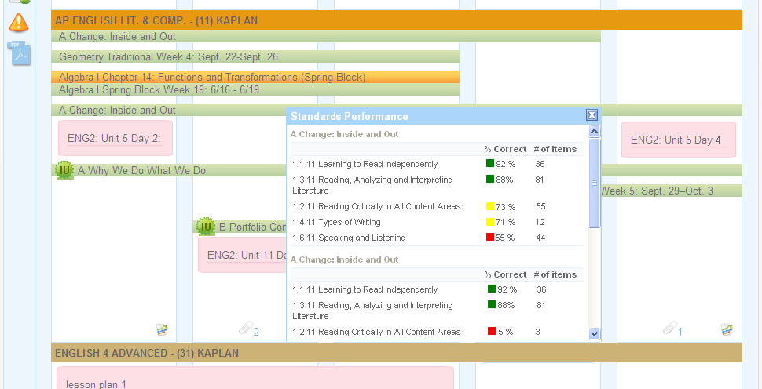
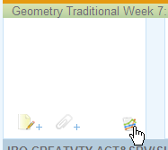
Embedded Standards Mastery
On the standards to be covered today, how have my students done so far this year on those standards?
Notes:
If standards are scheduled (via a material or standards coverage), a Standards Mastery view will appear to display the section’s recent performance on those scheduled standards

Slide 20
Copy Items
To copy a lesson (or other item) from one section to another, click and drag and drop to the additional location.
Notes:
If you teach the same lesson to two different classes, schedule it once and then drag and drop to additional sections

Slide 21
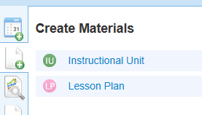
Create a New Lesson or Unit
Teachers can create their own instructional units and lessons by linking directly from the planner
Notes:
You can create these plus assessments and resources from the materials section

Slide 22
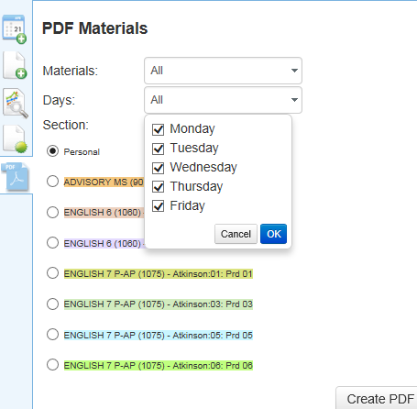
Print Materials for the Week
Select material type(s)
Select day(s)
Choose section
Hint: Click X to close pop-up window
Notes:
You can print instructional materials for a section for the week, or specific days. You will probably want to filter on material type, such as just lessons.

Slide 23
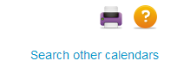
Accessing Planners as an Administrator
In the Planner, click ‘Search other calendars.’
Slowly type the teacher’s last name.
Click the teacher’s name in the ‘type-ahead’ menu.
Notes:
Administrators will see a link to search for teacher planners. They can type in a last name and select from the drop-down box.

