Slide 1
What is Assessment Admin?
Districts, schools and teachers may create and administer assessments online using ISEE
Teachers can use ISEE to:
Create and administer their own items and assessments for formative purposes
Quickly assess what students know about a particular topic

Slide 2
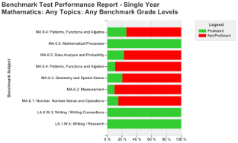
Test Administration Overview
1
2
3
4
5
Print answer
sheets and
booklets, or
usernames
Administer tests to students via paper or online
Results scanned or collected online
Performance data available online for analysis
Create tests and test scoring key
Notes:
This is the workflow…. Note that #5 happens in School & District Data and Classrooms. Teachers may print answer sheets, or can do centrally.

Slide 3
Available Items
SDE Idaho has loaded an item bank
Items come from other state or national assessments
Subjected to a standard test development protocol
Aligned to the Common Core State Standards as the preferred document.
If a strong alignment to CCSS is not evident the item has been aligned to the Idaho Content Standards
Districts are also sharing items
Items have not been subjected to the same test development protocol

Slide 4
Create Test Content (Items)
Create items separately or as part of a test.
TEST CENTRAL
ITEM CENTRAL
Select items from
Item Central
Set up test
Create items
Create items within test
Add items to Item Central
Notes:
<KEEP SLIDE ANIMATION>
In Assessment Admin, you can create test items in two different ways. You may already have a bank of items to start with (describe, if applicable). In some districts, tests may already be built and available.
<CLICK and TALK THROUGH FIRST WORKFLOW – TEST CENTRAL to ITEM CENTRAL>
<CLICK and TALK THROUGH SECOND WORKLOW – ITEM CENTRAL, THEN PULLED INTO A TEST>

Slide 5
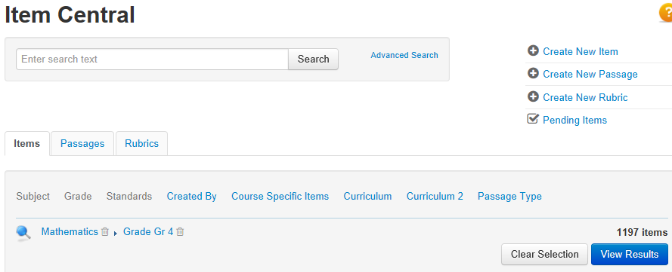
Locate Items, Passages, and Rubrics
Filter by subject, grade, standard and more.
Notes:
“Layer” filters to locate desired items, such as by keyword, grade, and subject
Advanced search options
This is why it’s important to add meta data to items
Give participants time to see what is available for the subjects and grades they teach

Slide 6
Create Items – Multiple Types Available
Multiple choice
True/false
Gridded
Open response (can attach a rubric)
Inline response
Matching
Hot spot
Tasks (a collection of items)
Attach any item type to a passage.
Notes:
If items are not available for your needs, it’s easy to build new items.
All item types are supported by paper and online formats, and some on clickers as well.
Demonstrate a basic multiple choice item with preview.
Note that alerts don’t refresh until the page does. You can ignore alerts unless you need to submit your work. Preview makes completed alerts go away.

Slide 7
Item Text Editor
Options: copy/paste, spell check, thesaurus, grammar checker, hyperlinks, special characters, grade level vocabulary (if loaded on site)
Notes:
Support of hyperlinks as part of the question content or answer choice with Online Test Tunnel and Secure Tester (PC or Mac). All hyperlinks displayed on original linked web page are disabled
Grade-Level Vocabulary available if district uploads a reference file by grade level in System >Assess > Item Properties

Slide 8
Insert Images
Do not copy and paste in an image; you must insert it as a file
For peak online test performance, use sizes below 250KB
Resize images before adding
Supported file formats: png, jpg, or gif
Not suggested for passages of text
Be sure to preview the item
Notes:
There is a size limitation. It will let you know if the image is too big.
Resize images before adding them in.

Slide 9
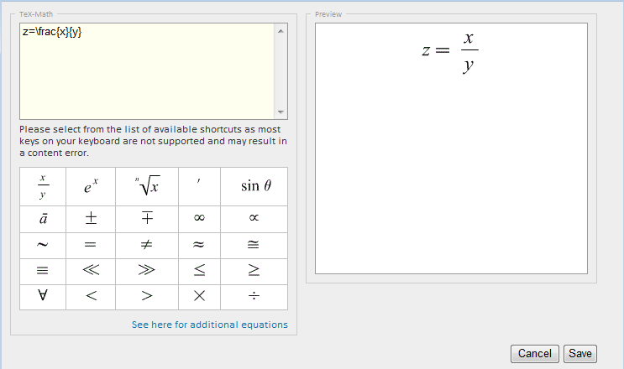
Equation Editor
Open the equation editor from the text editor
Link to additional equations and syntax to change font size
Notes:
You can put text in the window.

Slide 10
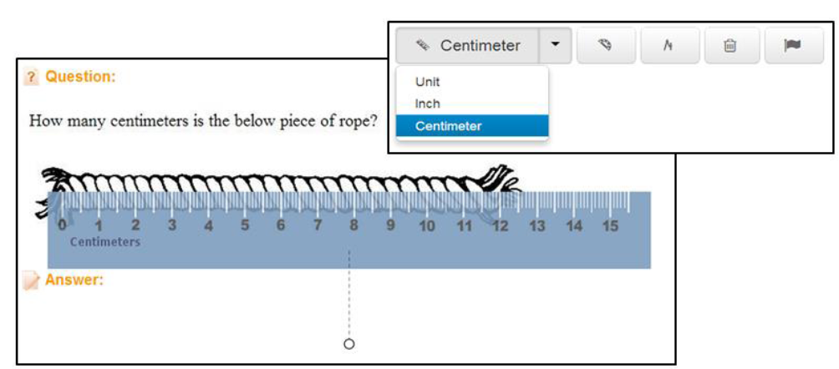
Math Manipulatives and Tools
Notes:
Something else for math teachers:
Make interactive manipulatives available to students for online testing on a test-by-test basis - online ruler, protractor, compass, and calculators.
Images in the test tunnels and printed test booklets are not scaled down; this ensures image measurements remain as intended
Each manipulative has its own button, which will launch the tool
Note: Due to a Safari 5 defect, we are unable to support manipulatives on this browser; if you have a Mac, use Safari 6 or Google Chrome
Refer to the QRC

Slide 11
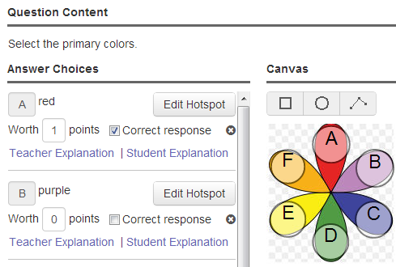
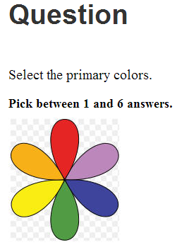
Hot Spot Items
Single and multiple selection items can be authored in Schoolnet
Online tests only
Hot Spot shapes can be defined as rectangles, circles, or polygons
IE 8 users are required to upgrade their browser version or download the Google Chrome Frame plug-in in order to author or edit hot spot items
Notes:
Demo how to create a hotspot item
Answer choice content is for reference in reporting– does not show in the final question that students see on the test
Can add negative points, although total must be at least zero
Tip – add standard last so that steps to complete goes away and you can submit the item
To accurately display the item on a test, images should not exceed 600 x 600 pixels
If resizing is needed, do so before uploading the image
Png, gif and jpg files up to 8 MB in size are supported

Slide 12
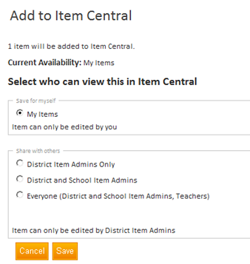
Item Visibility Options (Administrator View)
Notes:
Users who have permission to create items for other users will see this screen when they save an item. They have the option to choose who else will be able to see the item.
Discuss the use case for each option.

Slide 13
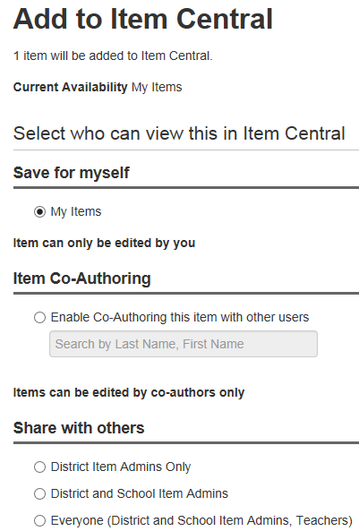
Item Visibility Options (Administrator View)
Determine who should have access to each item
Choose co-authoring to create items collaboratively
Notes:
Users who have permission to create items for other users will see this screen when they save an item. They have the option to choose who else will be able to see the item.
Discuss the use case for each option.
Co-authoring allow multiple users to collaborate. Can include a member with additional item rights to bypass the need for submit/approval. When the item is complete, anyone in the group with appropriate permissions can share the item to Item Central. User can select other users to co-author items with. List is restricted to users in the application that have the ability to create and edit items

Slide 14
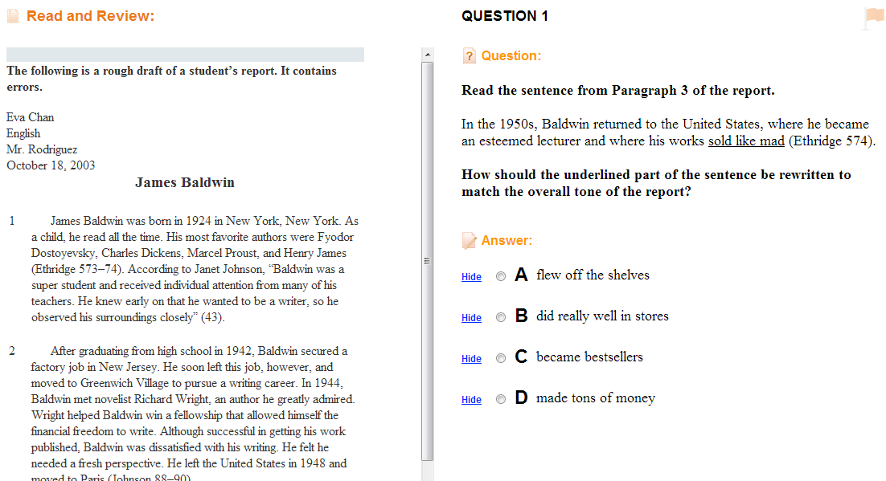
Create a Passage for Multiple Items
Notes:
Discuss the potential uses
Create the passage with the first item, then, when you create additional items, link the new passage to them
Add subject and grade, type
Orientation—can change later
Save or add a new item
Passage orientation is for online testing only

Slide 15
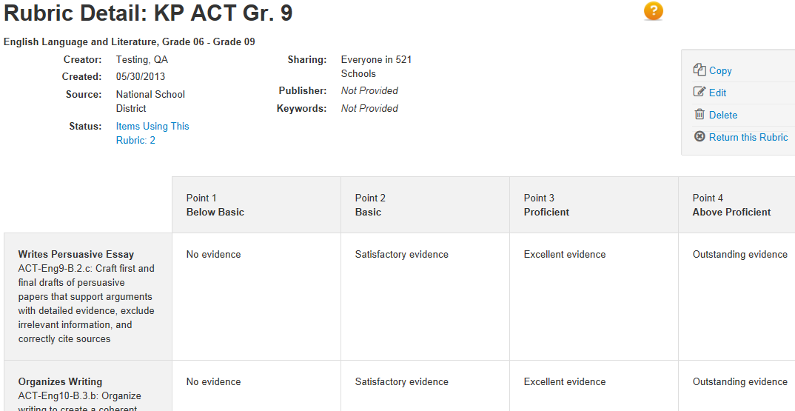
Rubric for Open Response Items
Single or multidimensional rubrics
Notes:
Contrast to scoring instructions; if you have multiple items for the same rubric, it’s worth it to building a rubric.
Will replace a standard on an item
Lowest level first
Can define a 0 level
Refer to QRC

Slide 16
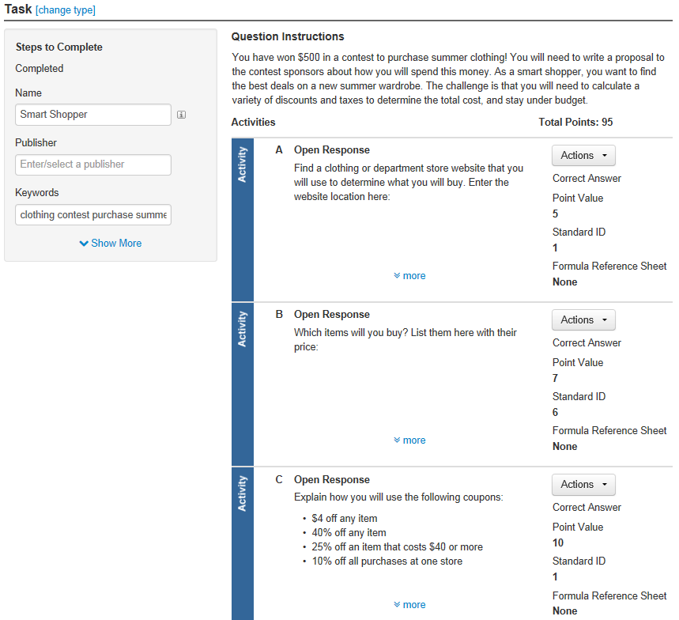
Tasks
A task is a collection of items that you can reuse
Each item can have a different standard and point value
Group items that are part of a project and can’t stand alone
Notes:
Tasks are useful for multi-step project assignments that cover multiple skills.

Slide 17
Submitting and Approval Process
Any user can submit an item, passage, or rubric to be shared
Users who are permissioned to do so can approve content at their default institution
Once approved, the submitter can no longer edit the content
Notes:
Know the process selected for this audience. Describe all options if the process is not yet decided.
Refer to QRCs.

Slide 18
Create and Schedule a test

Slide 19
Two Kinds of Tests
Benchmark
Results appear in School & District Data and Classrooms
Tests created at the district or school level for the purpose of institution-wide data collection
Only the highest level category used for KPI calculations
Classroom
Results appear in Classrooms only
Tests created for the purpose of classroom use
Can be teacher-created or selected from a pool of pre-made tests
My Classroom or Common Classroom categories available
Notes:
In Assessment Admin, you can create two kinds of tests. Benchmark is a generic term that covers all interim assessments not loaded as standardized tests. You might call them progress checks, baselines, minis, and the like. You can make tests required or optional for teachers.

Slide 20
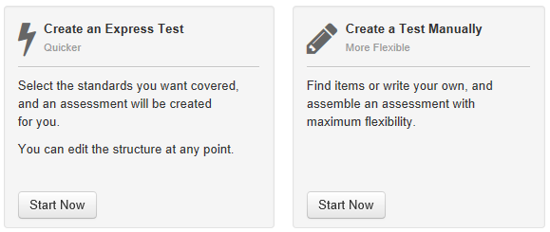
Ways to Create a Test
Express test
Manual test
Notes:
Express test (with or without existing items), add passages manually
Manual test–either from within Item Central or start new
Naming conventions
Review test categories
If teachers have access to create common classroom, they also have school benchmark category—be sure to pick appropriately
All multiple choice options
Explain AKO option
Score type
Customization options on test: Numbering, cut scores, attach resources

Slide 21
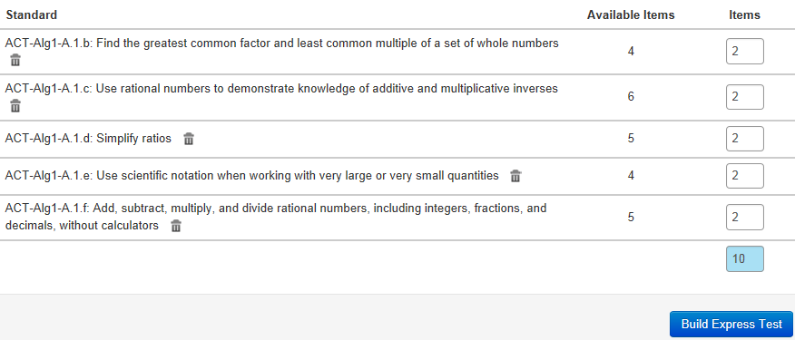
Express Test Method
Select the standards to include and the number of items for each standard.
Notes:
How it differs:
No passages
OK if no items
Tip: Request more than you need so you can pick the best options.

Slide 22
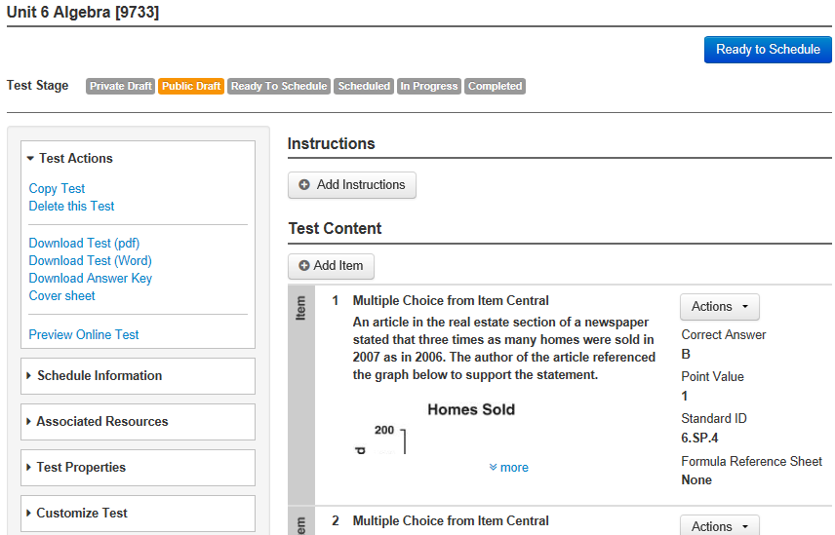
Manual Method
Add your own questions or use existing items.
Notes:
Discuss adding instructions, customization options and associated resources

Slide 23
Options for Test Item Settings
Enable text formatting
Enable student comments
Capture teacher comments on answer sheet
Enable self-assessment
Hide item content from students and parents
Enable tools and manipulatives
Specify number of items on test
Notes:
Describe each option
Note that enabling teacher comments on answer sheets uses more paper
Sometimes easier to specify only a few items and then add once in the test detail
Questions left unanswered can be excluded from the score. Available only for “My Classroom” tests

Slide 24
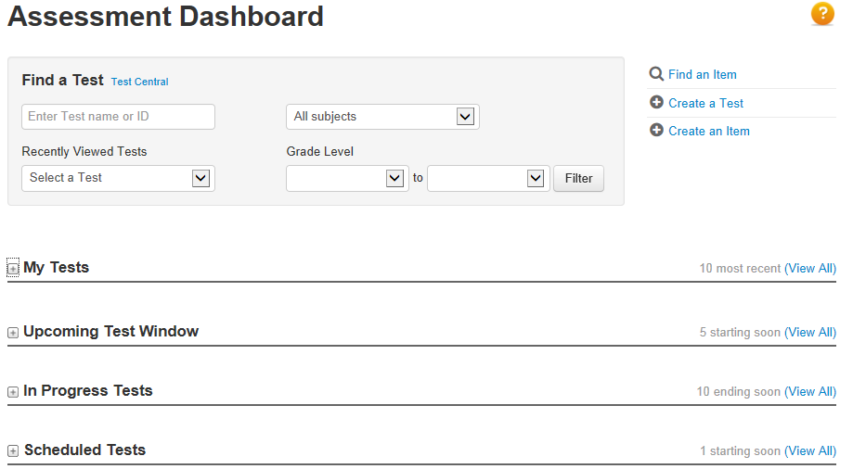
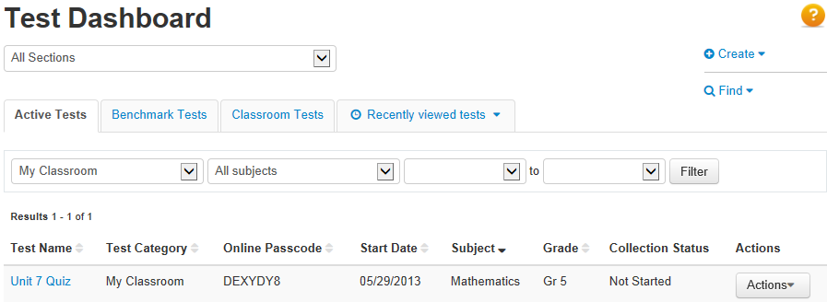
Where is my test?
Two dashboard versions
Notes:
Screen varies for teachers with no extra permissions
Use to locate tests
Point out recently viewed test drop-down menu

